Slide 1




Industrial applications-oriented, microwave modeling in Elmer
Roman Szewczyk ^{1,2}, Anna Ostaszewska-Liżewska ^{1,2},
Dominika Kopala ¹, Jakub Szałatkiewicz ^{2,3}
roman.szewczyk@pw.edu.pl, anna.lizewska@pw.edu.pl, dominika.kopala.stud@pw.edu.pl, jakub.szalatkiewicz@gmail.com
¹⁾ Warsaw University of Technology, Faculty of Mechatronics
²⁾ Łukasiewicz Research Network - Industrial Research Institute for Automation and Measurements, Warsaw, Poland
³⁾ Phoenix Surowce sp. zoo, Warsaw, Poland
20.05.2021
Warsaw-Espoo, Elmer FEM free webinar series

Slide 2
Plan of the presentation:
Roman Szewczyk (PhD., DSc., ProfTitul.) - few words about the history and the most important ideas behind our work.
Anna Ostaszewska-Liżewska (PhD.) – meshing for Elmer microwave modelling, problems with presentation of 3D vector fields.
Dominika Kopala (engineer, M.Sc.-student) – microwave models and .sif file
Jakub Szałatkiewicz (PhD., DSc.) – practical applications of microwave technology and Elmer models

Slide 3
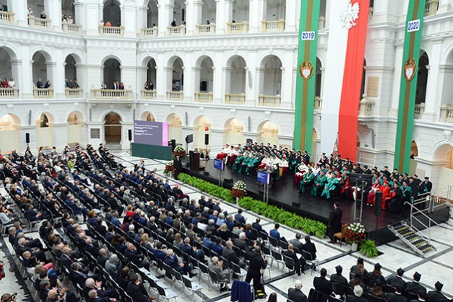

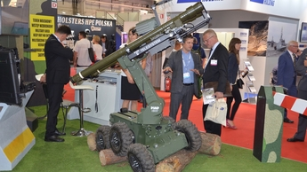
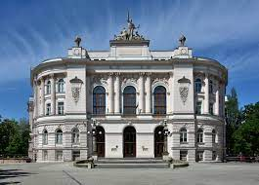
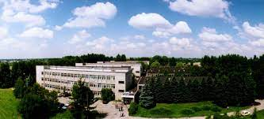
Warsaw University of Technology
Faculty of Mechatronics
Leading Polish technical university since 1915
19 faculties, 30 000 students
ŁUKASIEWICZ Research Network –
Industrial Research Institute
for Automation and Measurements
Technology transfer oriented, public
research institute, since 1965.
Both in Warsaw, Poland

Slide 4
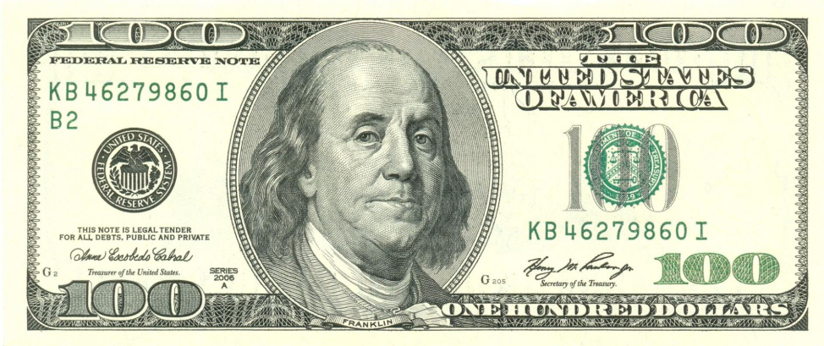
Our adventure with ELMER FEM started in 2012.
In cooperation with RADWAG, Polish private company we undertaken
the development of laboratory microwave moisture analyzers
– tool for assessment of humidity level in biological materials,
such as wood, yoghurt, etc.
Laboratory microwave moisture analyzers:
2 producers around the world,
very expensive,
highly profitable.

Slide 5
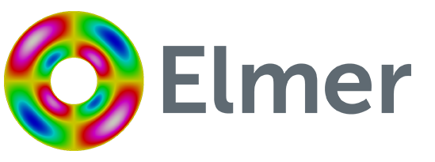
Barrier:
Microwave chamber of laboratory microwave moisture analyzer
has to be kept in resonance.
To determine the geometry of the microwave chamber
suitable for the resonance,
you need to model it using finite elements method.
Cost of commercial software – half of our project’s budget.
Solution: ELMER FEM

Slide 6
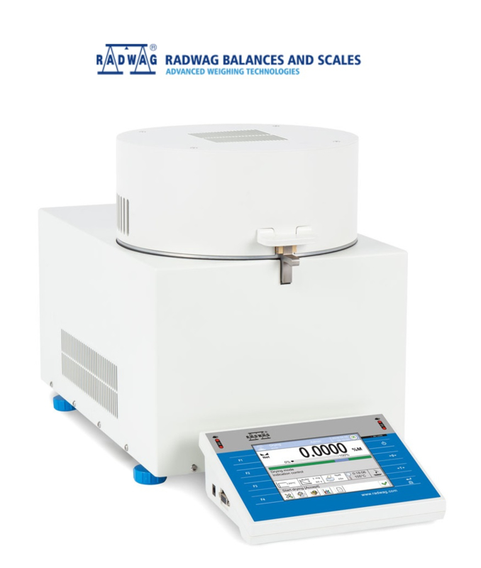
ELMER TEAM: developed microwave module for ELMER FEM
PIAP, WUT: developed the project of microwave chamber
RADWAG: developed the laboratory
microwave moisture analyzer
and introduced it to the global market
Third company in the global market!
https://radwag.com/en/
pmv-50-microwave-moisture-analyzer,4,401-153

Slide 7
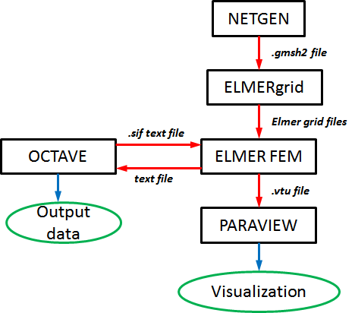
Now, we use ELMER FEM as a standard for our education and research.
No problem with commercialization.
Easy integration in large software
structures for optimization.
Possible to integrate our own models
(tensor description of permeability -
- mechanical stresses dependences).
R. Szewczyk, M. Nowicki, A. Ostaszewska-Liżewska,
A. Bieńkowski , P. Nowak, M. Malinen
„Accuracy of frame-shaped samples based measurements
of magnetoelastic characteristics of soft magnetic materials”
Measurement 162 (2020) 107899

Slide 8
Let us guide you through all microwave system modelling process.
First: tetrahedral meshes for modelling

Slide 9
First: tetrahedral meshes for modelling - why Netgen?
More control -> external mesh generators -> open source:
GMSH - the most popular, fast, light and user friendly, with GUI
Salome - a great cross platform for pre- and postprocessing
FreeCAD - parametric modelling
Netgen - modules for mesh optimization and mesh refinement, writes meshes in Elmer format (linear only)
Remote control of cumputing
text mode
Computing series automation with sripts

Slide 10
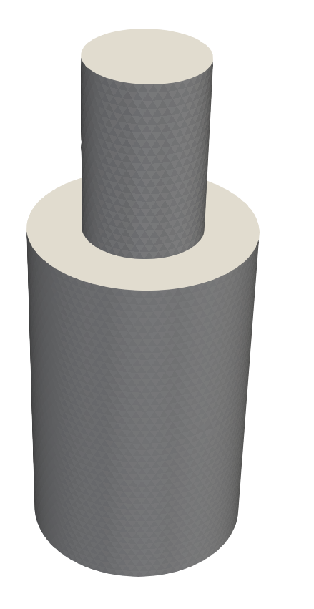
160 mm
algebraic3d
# ------------- Waveguide -------------
solid UP_PIPE = plane(0,0,0;0,0,-1);
solid DOWN_PIPE = plane(0,0,300;0,0,1);
solid PIPE = cylinder(0,0,-100;0,0,400;80);
solid WAVEGUIDE = PIPE and DOWN_PIPE and UP_PIPE;
# ------------- Chamber -------------
solid UP_BOX = plane(0,0,240;0,0,-1);
solid DOWN_BOX = plane(0,0,720;0,0,1);
solid BOX = cylinder(0,0,200;0,0,800;151);
solid CAVITY = BOX and DOWN_BOX and UP_BOX;
# --------- Join waveguide + chamber ---------
solid MIC = WAVEGUIDE or CAVITY;
# generate object
tlo MIC;
720 mm
480 mm
302 mm

Slide 11
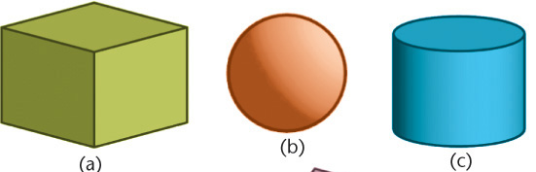
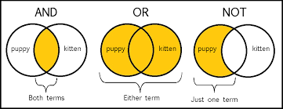
Step one: define gometry
160 mm
Define solid primitives
Conduct a logical operation
Generate solid
720 mm
480 mm
302 mm

Slide 12
algebraic3d
#------------- Waveguide -------------
solid PIPE = cylinder(0,0,-100;0,0,400;80);
# generate object
tlo PIPE;
comment
primitive
name
type
X_{a}, Y_{a}, Z_{a}; X_{b}, Y_{b}, Z_{b}
AB points of the axis
radius

Slide 13
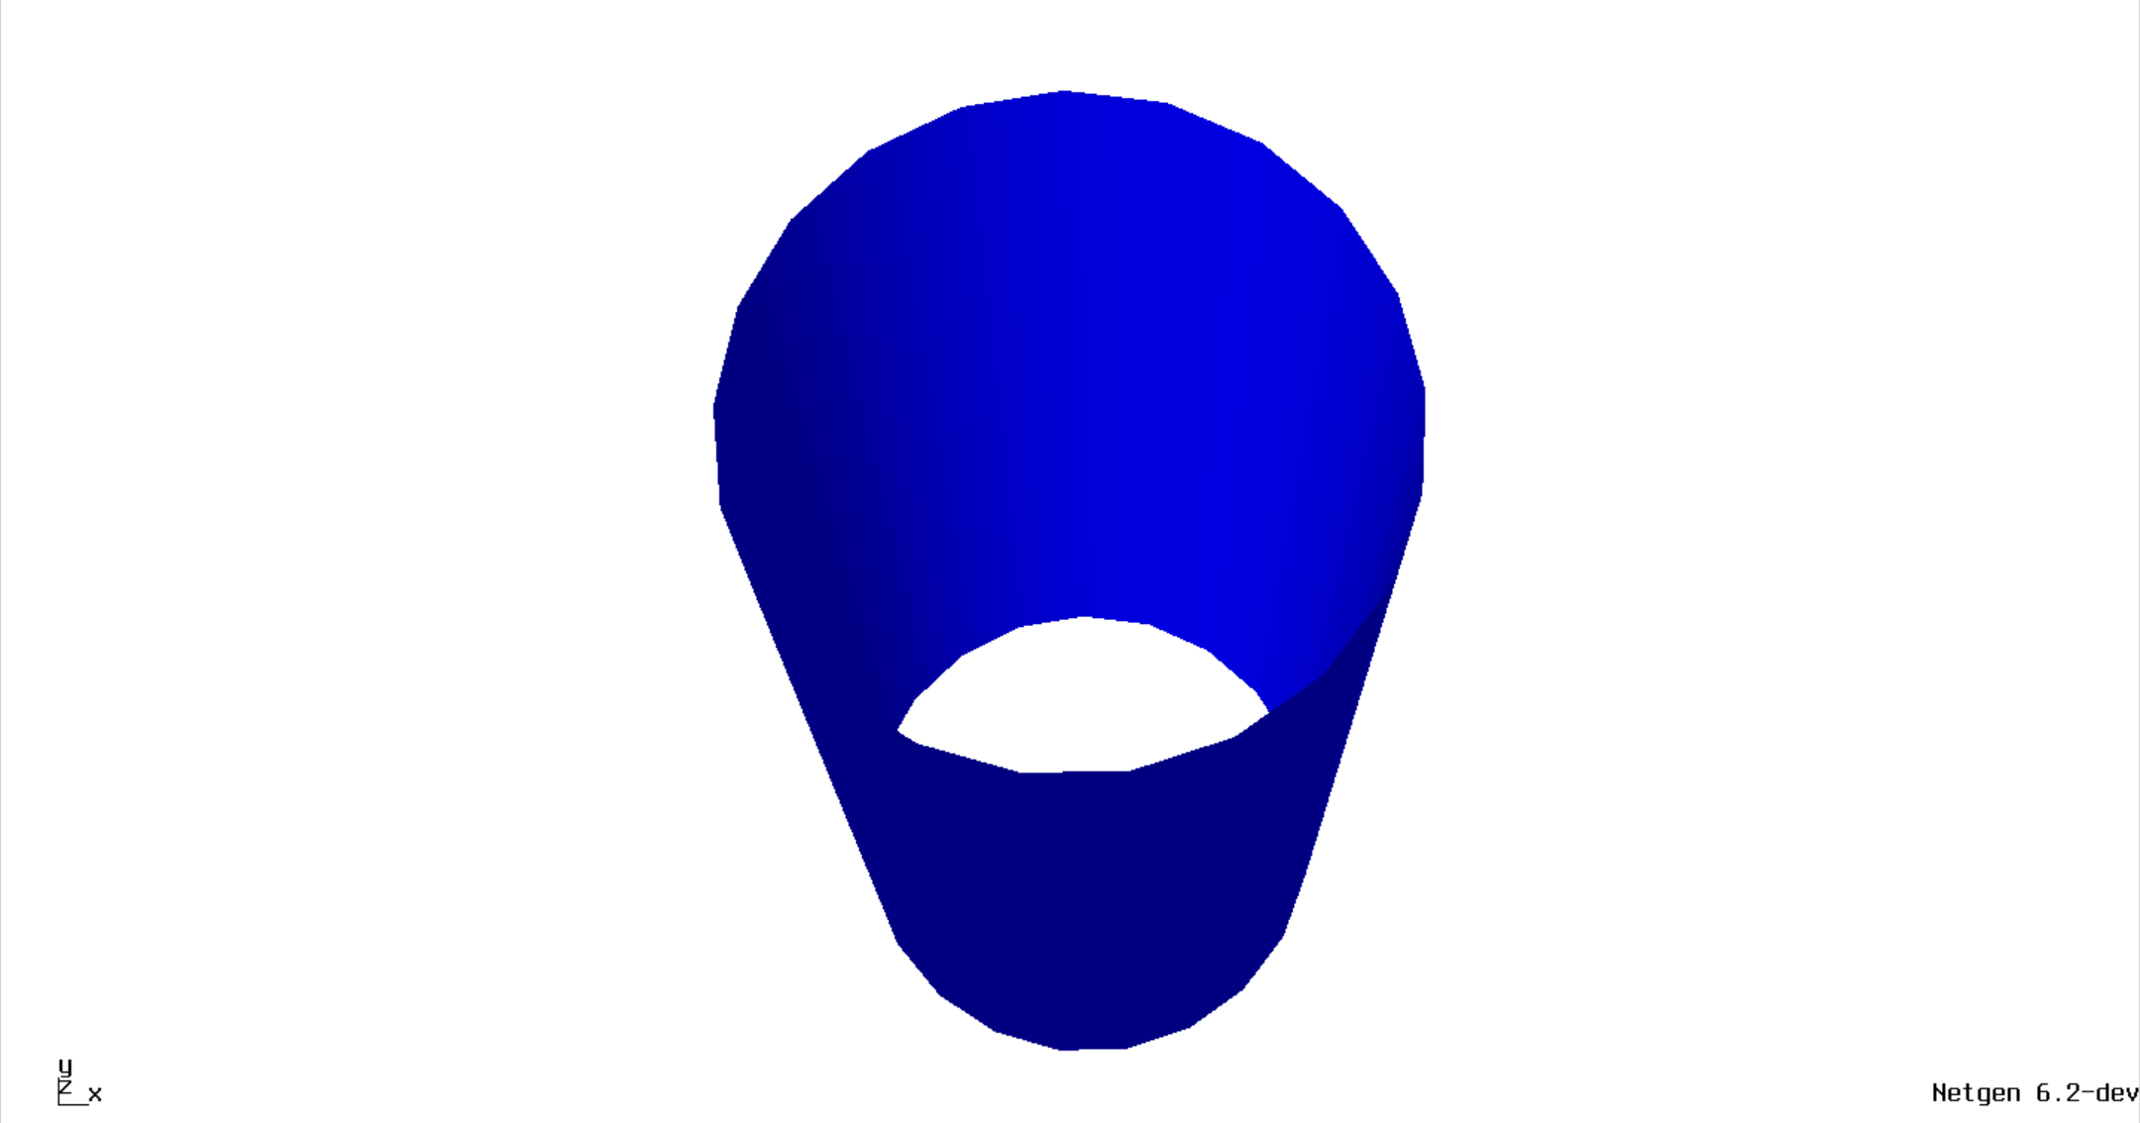

Slide 14

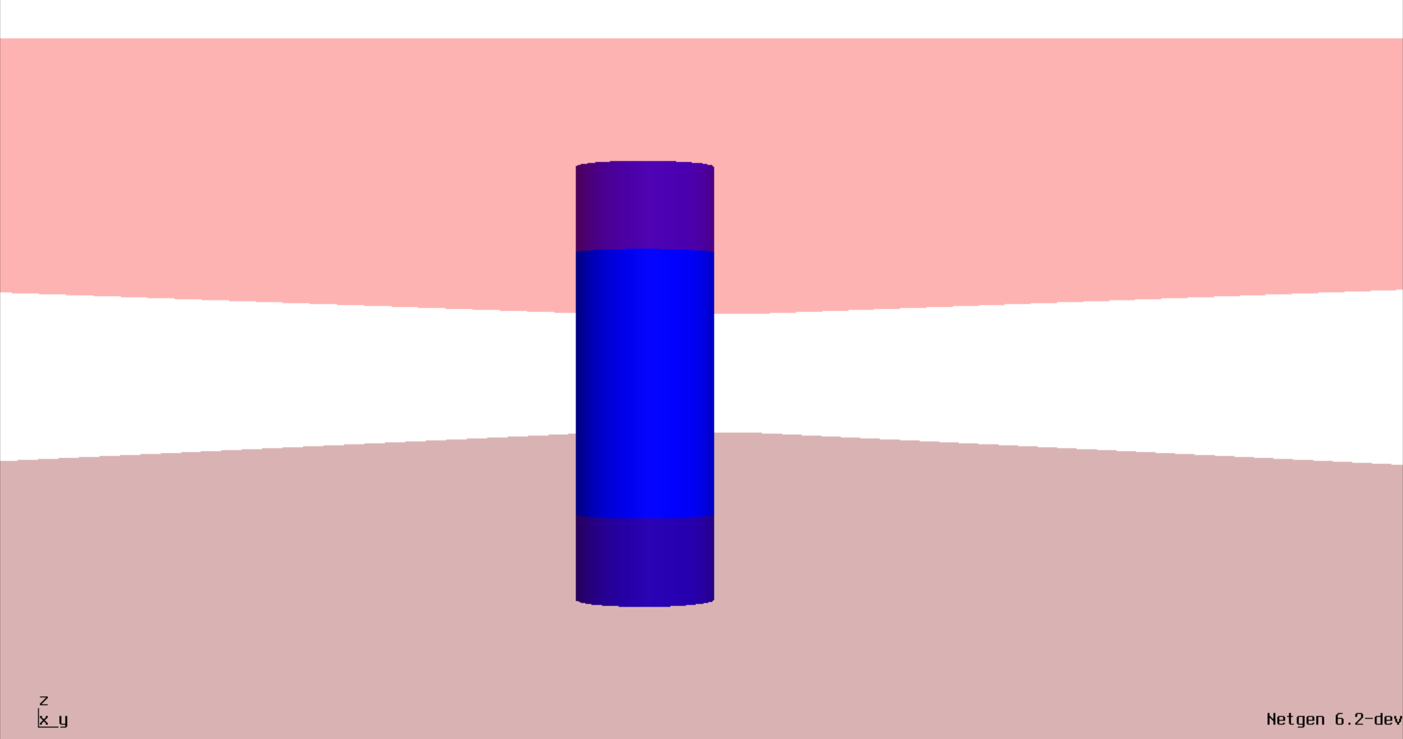
Lifehack alert!

Slide 15
algebraic3d#
------------- Waveguide -------------
solid PIPE = cylinder(0,0,-100;0,0,400;80);
solid UP_PIPE = plane(0,0,0;0,0,-1);
solid DOWN_PIPE = plane(0,0,300;0,0,1);
solid WAVEGUIDE = PIPE and DOWN_PIPE and UP_PIPE;
# generate object
tlo WAVEGUIDE;
primitive
name
type
P_{x}, P_{y}, P_{z}; n_{x}, n_{y}, n_{z}
point of the plane; coordinates of normal vector
logical operation on solids

Slide 16
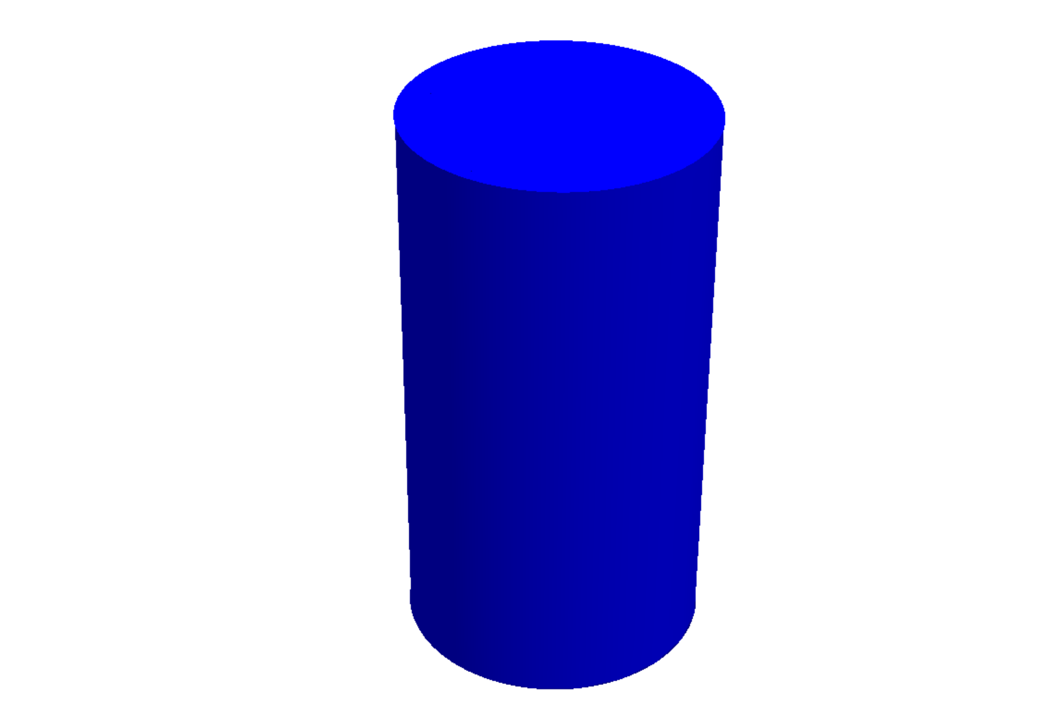

Slide 17
algebraic3d#
------------- Waveguide -------------
solid UP_PIPE = plane(0,0,0;0,0,-1);
solid DOWN_PIPE = plane(0,0,300;0,0,1);
solid PIPE = cylinder(0,0,-100;0,0,400;80);
solid WAVEGUIDE = PIPE and DOWN_PIPE and UP_PIPE;
# ------------- Chamber -------------
solid UP_BOX = plane(0,0,240;0,0,-1);
solid DOWN_BOX = plane(0,0,720;0,0,1);
solid BOX = cylinder(0,0,200;0,0,800;151);
solid CAVITY = BOX and DOWN_BOX and UP_BOX;
# --------- Join waveguide + chamber ---------
solid MIC = WAVEGUIDE or CAVITY;
# generate object
tlo MIC;
Generate the final solid only
Notes:
we use the tlo command to generate the object

Slide 18
Lifehack alert: changing units in Netgen
algebraic3d#
------------- Waveguide -------------
solid UP_PIPE = plane(0,0,0;0,0,-1);
solid DOWN_PIPE = plane(0,0,300;0,0,1);
solid PIPE = cylinder(0,0,-100;0,0,400;80);
solid WAVEGUIDE = PIPE and DOWN_PIPE and UP_PIPE;
# ------------- Chamber -------------
solid UP_BOX = plane(0,0,240;0,0,-1);
solid DOWN_BOX = plane(0,0,720;0,0,1);
solid BOX = cylinder(0,0,200;0,0,800;151);
solid CAVITY = BOX and DOWN_BOX and UP_BOX;
# --------- Join waveguide + chamber ---------
solid MIC = WAVEGUIDE or CAVITY;
# generate object
tlo MIC;
Geometry defined
in meters

Slide 19
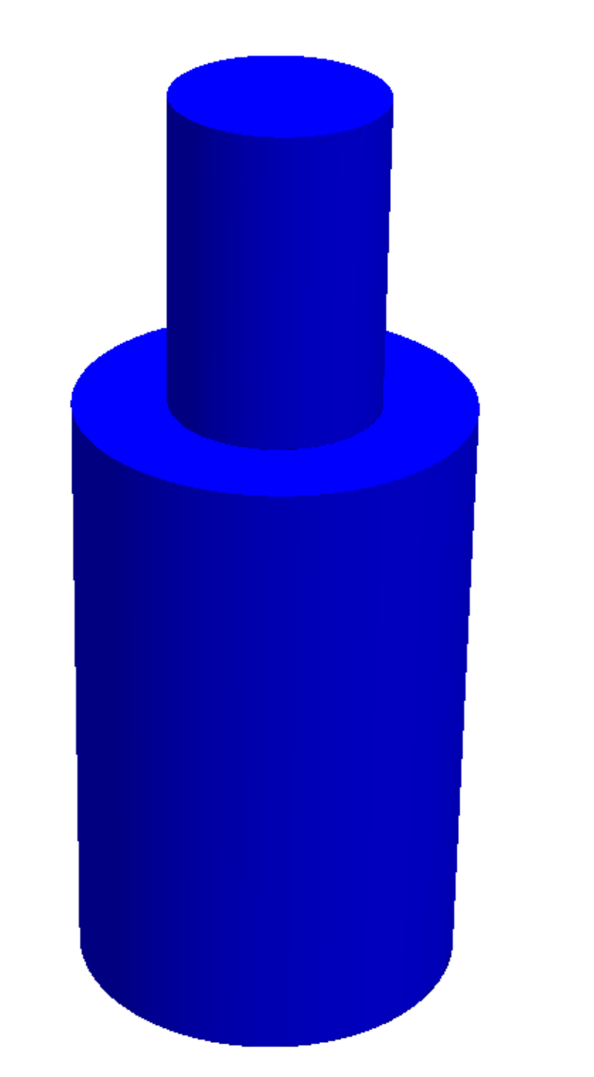
Step two: generate the mesh

Slide 20
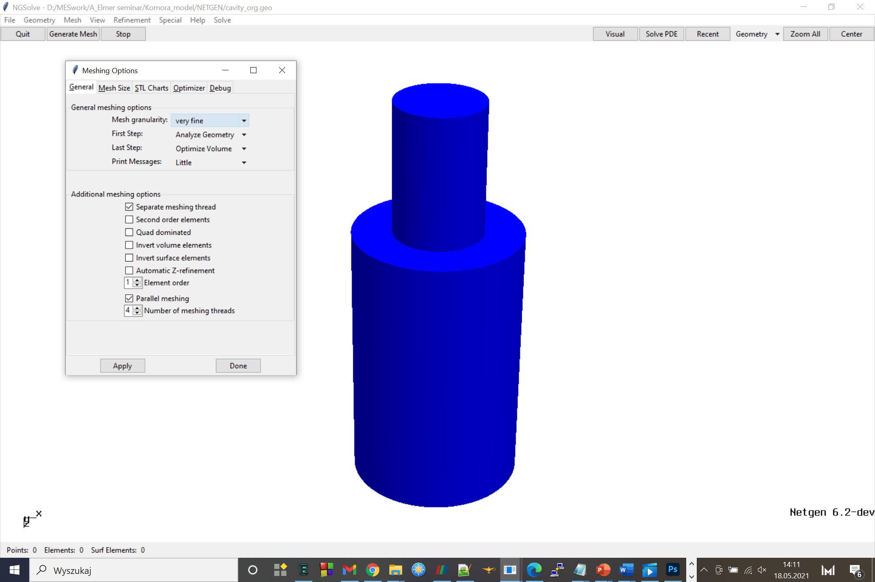

Slide 21
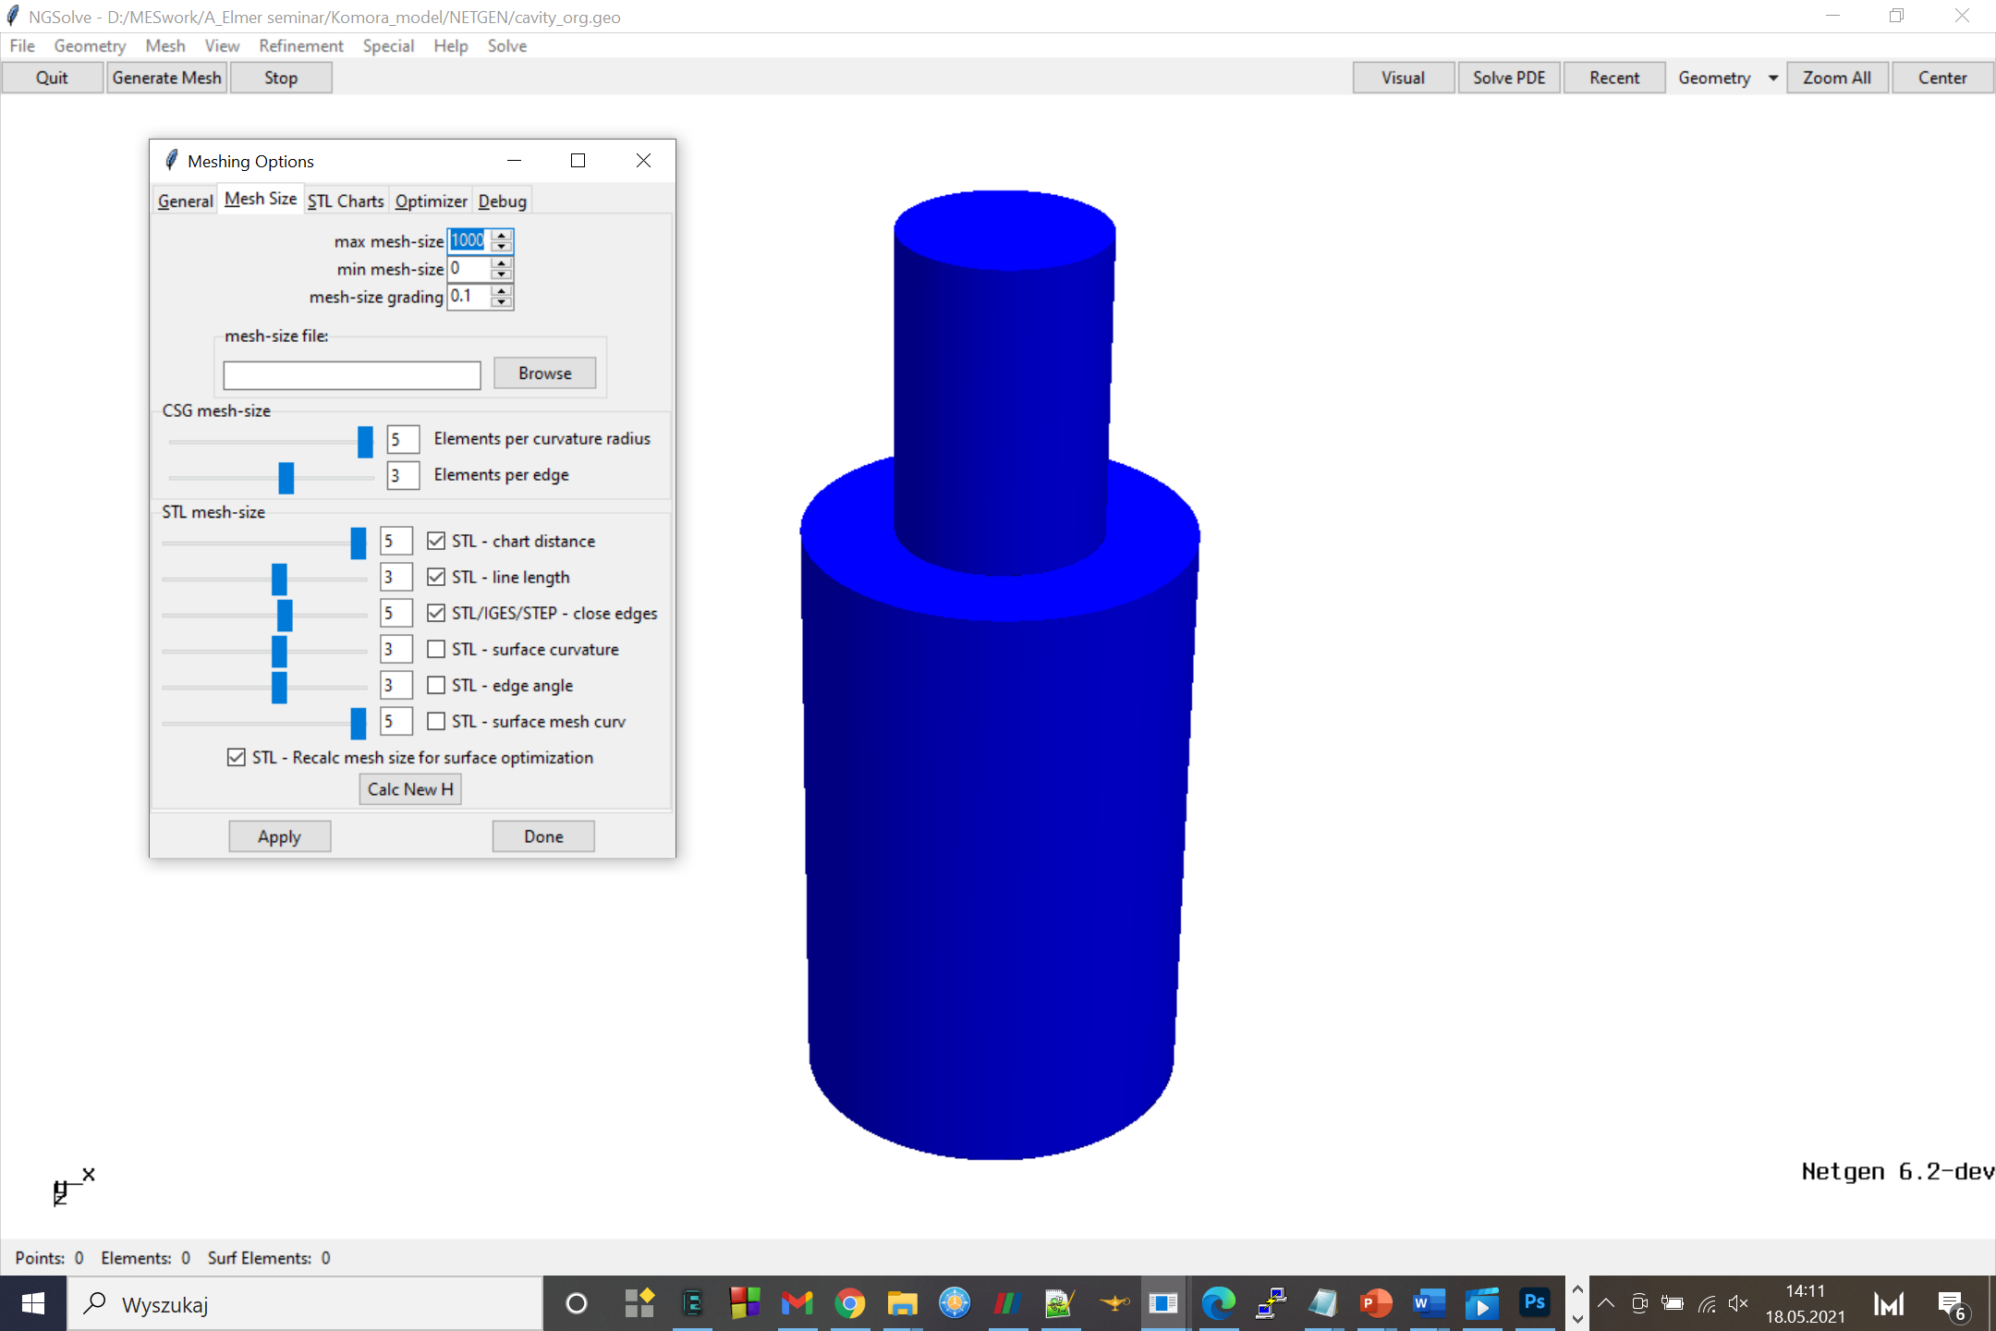

Slide 22


Slide 23


Slide 24
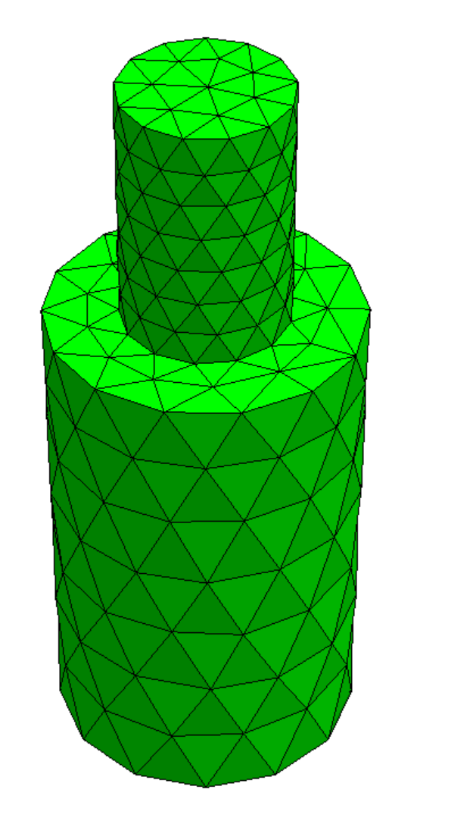
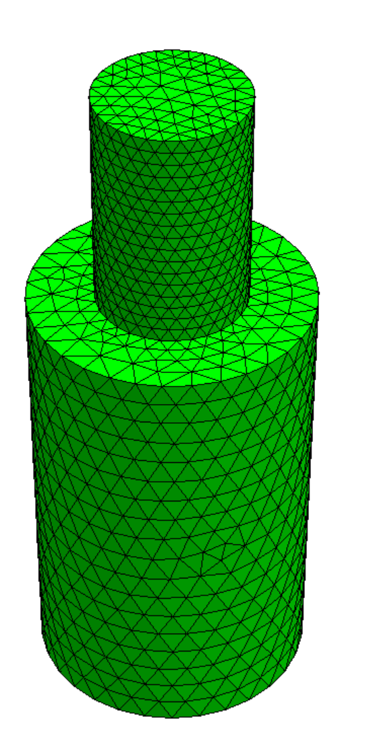
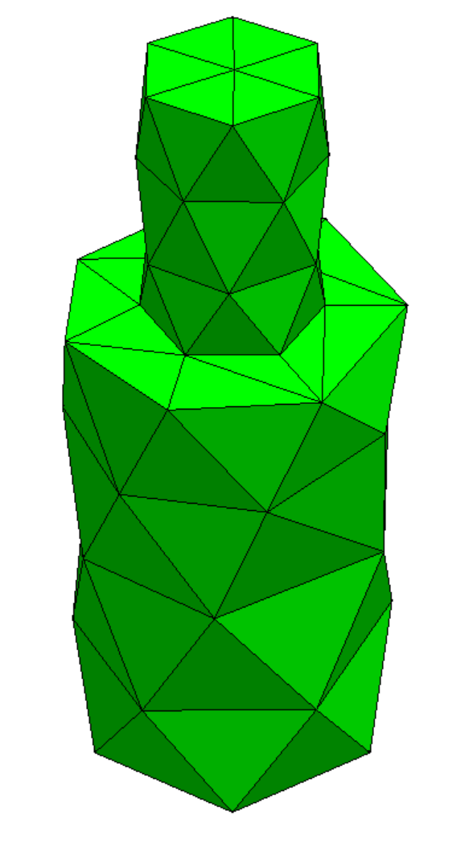
Mesh -> meshing options -> mesh granularity:
very coarse
moderate
very fine

Slide 25
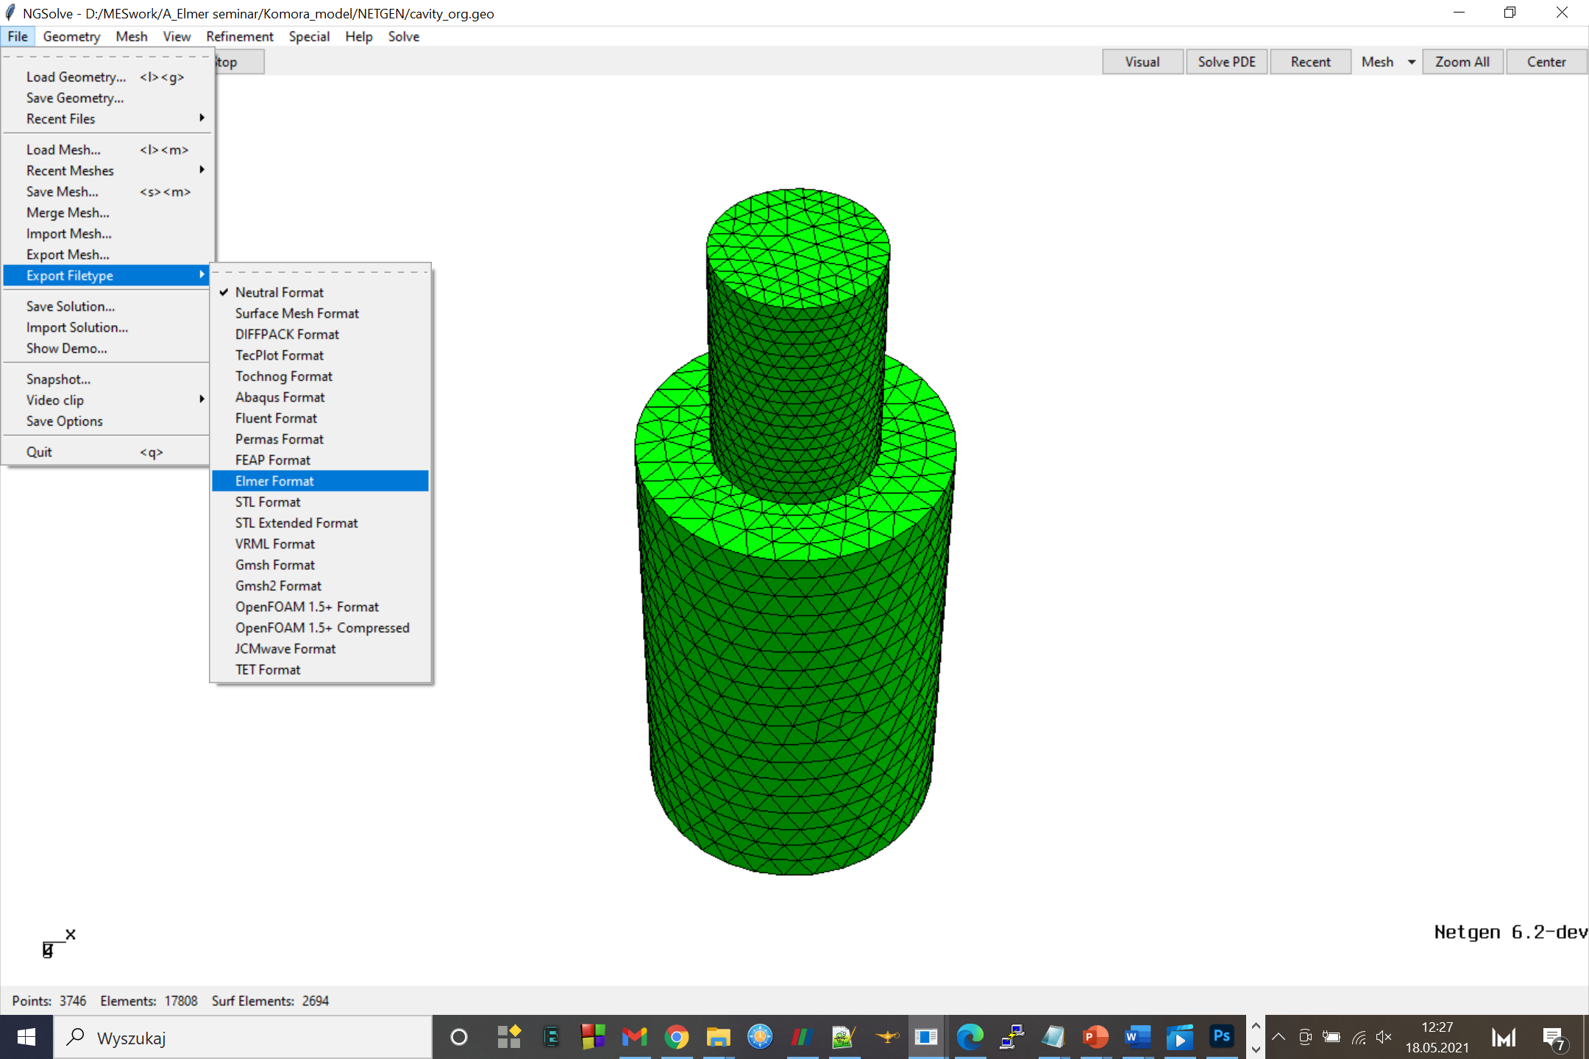

Slide 26
No elmer file type -> convert with ElmerGrid:
ElmerGrid #in #out meshname – parameters
ElmerGrid 14 2 tensductor.gmsh2 -scale 0.001 0.001 0.001 -autoclean
from m to mm
For bodyID and Boundary Index numbering from 1
Lifehack alert!

Slide 27
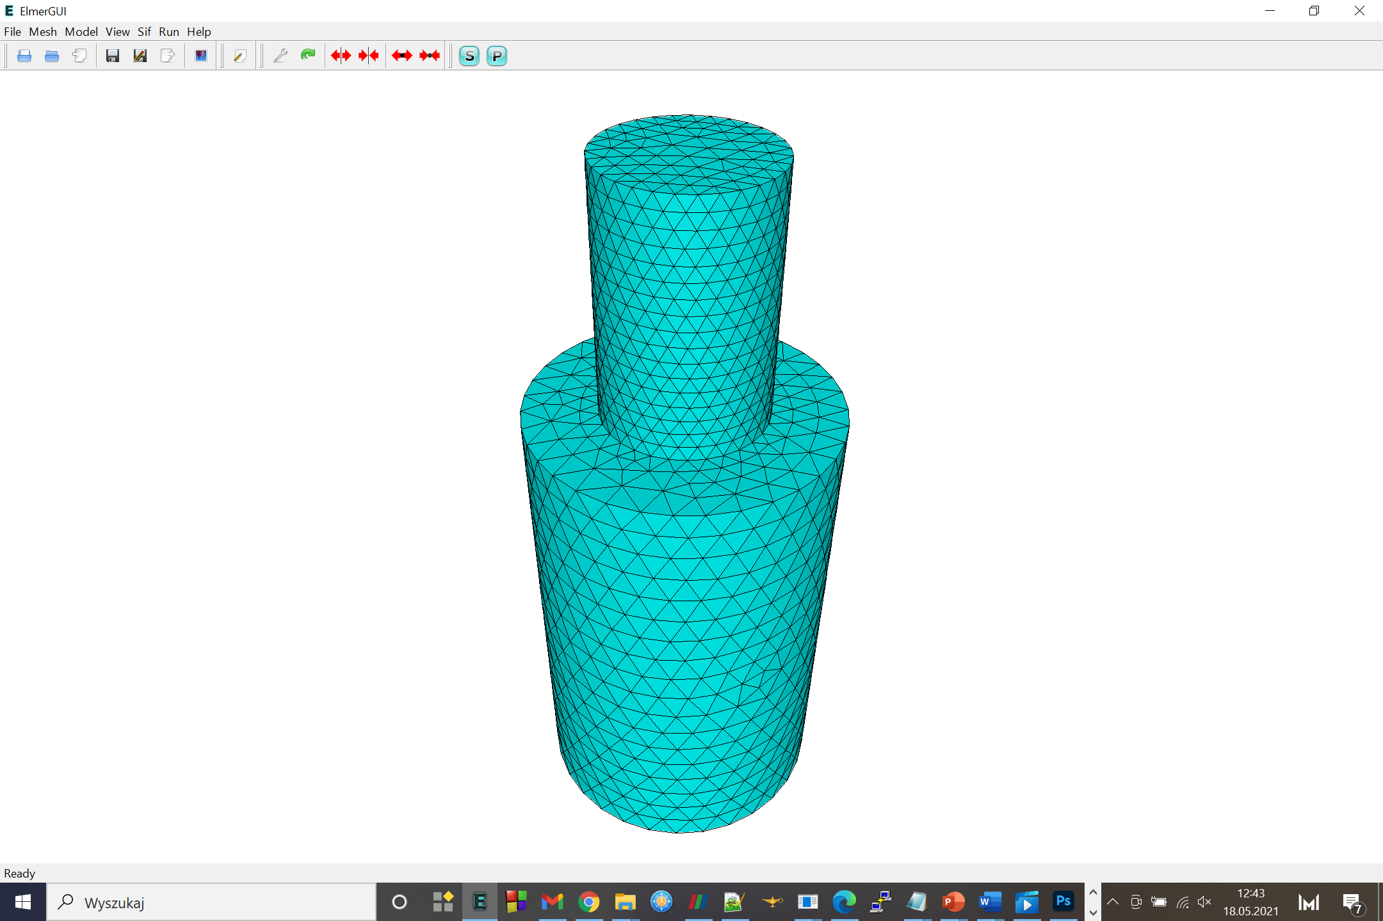
Ready to set the .sif file

Slide 28

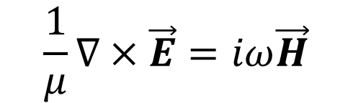



Electromagnetic field – described by Maxwell equations
Faraday’s law
$$\frac{1}{μ}∇×\vec{E}=iω\vec{H}$$
$$\vec{E}$$
electrical field
$$\vec{H}$$
magnetic field strength
Ampère’s law
$$∇×\vec{H}=−iωε\vec{E}+\vec{J}$$
$$\vec{J}$$
impressed current distribution
Time-harmonic form enables introducing wave frequency given in ω = 2πf
In terms of EM waves Maxwell equations are transformed into Helmholtz equations

Slide 29
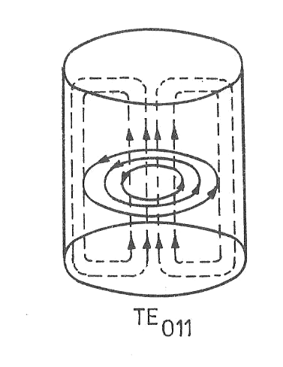
Model parameters
Resonance frequency – f = 2,5 GHz
Material:
  walls – copper
  interior of the chamber – air
Chamber’s shape: cylindrical
Waveguide’s shape: cylindrical
Construction: axisymmetric
Wave type: TE011
  TE – EM field vector configuration
  m = 0, n = 1, p = 1 - modes
  determines the form of Helmholtz
  equations and the shape of EM
  field distribution
Source: DOBROWOLSKI J.A. Mikrofale.(Microwaves) Warszawa, Wydawnictwa PW, 1991

Slide 30
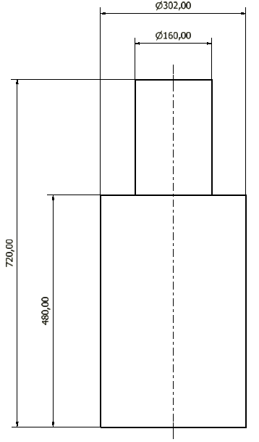
Size of the model
Chamber’s size:
  Diameter: 302 mm
  Length: 480 mm
Waveguide’s size:
  Diameter: 160 mm
  Length: 240 mm
Length is an integer multiple of the wavelength
Chamber’s diameter is calculated from equation for resonance frequency dependent on chamber’s dimension
Waveguide’s diameter chosen based on phase constant value (needs to be real value)

Slide 31

Specific Helmholtz equation
wave identifying vector
n-th root of the derivative of m-th order Bessel function
amplitude of Hz in point (0,0,0) for t = 0
cylindrical coordinates
$$H_{z}={H_{z}(0)J}_{m}\left(\frac{{u′}_{mn}}{r}∙ρ\right)∙cos{(}mφ)∙e^{−jβ_{z}∙z}$$
m-th order Bessel function
waveguide’s radius
phase constant

Slide 32
Basic parts of .sif file
Simulation
Simulation Max Output Level = 9 Coordinate System = "Cartesian" Simulation Type = Steady Timestepping Method = BDF Timestep Sizes = 1 Timestep Intervals = 10 Steady State Max Iterations = 1 Post File = case.vtu Output Intervals(1) = 1 End
Steady type - solution for a steady state
No time stepping solutions required
Result file in .vtu format
Equation
Equation 1 Name = "VectorHelmholtz_equation" Active Solvers(3) = 1 2 3 Angular Frequency = Real $w End
Angular frequency given by
ω = 2πf

Slide 33
Solvers
VectorHelmholtzSolver
VectorHelmholtzCalcFields
SaveGridData
Implement Maxwell equations
Calculate values of EM wave parameters
Save values of EM wave parameters in an external file
Specific for the problem
Universal

Slide 34


VectorHelmholtzSolver
Solver 1 Equation = "VectorHelmholtz" Variable = E[E re:1 E im:1] Procedure = "VectorHelmholtz„ "VectorHelmholtzSolver" … End
Parameters are calculated relative to the vector E
Constants
! Constants for wave equation $ beta=21.243 $ beta_lim=47.896 $ const=0.013292 $ w=2*pi*(2.5e9) ! Constant for Leontovich boundary condition $ l=767340
Phase constant β
Limit phase constant βlim
$const=\frac{d_{wave}}{π{u′}_{01}}$
Angular frequency ω = 2πf
$l=μ_{0}\sqrt{\frac{ω_{res}∙σ_{Cu}}{2μ_{Cu}}}$

Slide 35
VectorHelmholtzCalcFields
Solver 2 Equation = "calcfields" Procedure = "VectorHelmholtz" "VectorHelmholtzCalcFields" Field Variable = String "E" Calculate Elemental Fields = Logical True Calculate Magnetic Field Strength = Logical True Calculate Magnetic Flux Density = Logical True Calculate Poynting vector = Logical True Calculate Div of Poynting Vector = Logical True Calculate Electric field = Logical True Calculate Energy Functional = Logical True … End
For „SaveGridData” solver only Electric field E and Magnetic Field Strength H vectors are saved in an external file

Slide 36
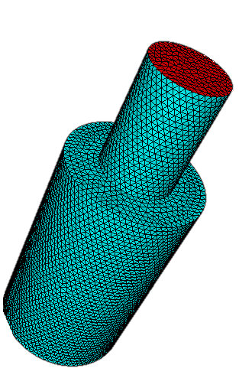
Boundary conditions
Inport
Walls
Source of EM wave
Described by the wave equation specific for the wave type
Energy absorbing material - copper
Described by Leontovich impedance boundary condition

Slide 37
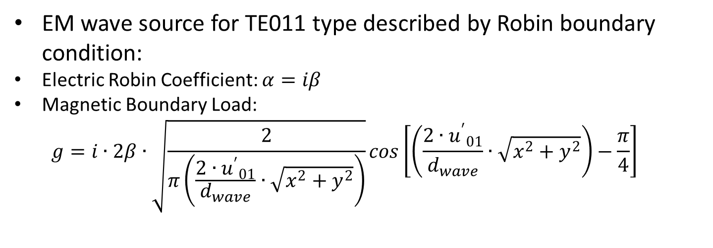
Inport
Boundary Condition 1 Target Boundaries(1) = 2 Name = "Inport" Electric Robin Coefficient im = Real $ beta Magnetic Boundary Load im 2 = Variable Coordinate 1, Coordinate 2 Real MATC "2*beta*sqrt(const/sqrt(tx(0)*tx(0)+tx(1)*tx(1))) *cos(beta_gr*sqrt(tx(0)*tx(0)+tx(1)*tx(1))-0.785398)" End
EM wave source for TE011 type described by Robin boundary condition:
Electric Robin Coefficient: $α=iβ$
Magnetic Boundary Load:
  $$g=i∙2β∙\sqrt{\frac{2}{π\left(\frac{{{2∙u}^{′}}_{01}}{d_{wave}}∙\sqrt{x^{2}+y^{2}}\right)}}cos\left[\left(\frac{{{2∙u}^{′}}_{01}}{d_{wave}}∙\sqrt{x^{2}+y^{2}}\right)−\frac{π}{4}\right]$$
Simplified Bessel function

Slide 38
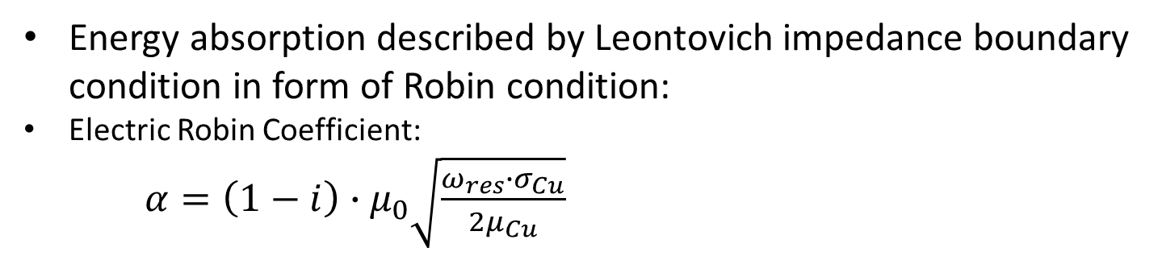
Walls
Boundary Condition 2 Target Boundaries(4) = 1 3 4 5 Name = "Walls" ! Leontovich impedance boundary Electric Robin Coefficient = Real $ -l Electric Robin Coefficient im = Real $ l End
Energy absorption described by Leontovich impedance boundary condition in form of Robin condition:
Electric Robin Coefficient:
$α=\left(1−i\right)∙μ_{0}\sqrt{\frac{ω_{res}∙σ_{Cu}}{2μ_{Cu}}}$
Walls material’s parameters
Interior material’s parameter

Slide 39
Code files
Code for the project available on GitHub:
GEO file for geometry
SIF file for ELMER FEM solver
https://github.com/DKopala/MicrowaveChamber

Slide 40
Data analysis and visualization
ParaView:
open-source, multi-platform application
qualitative and quantitative visualisation
interactive data exploration in 3D
batch processing
high performance computation

Slide 41
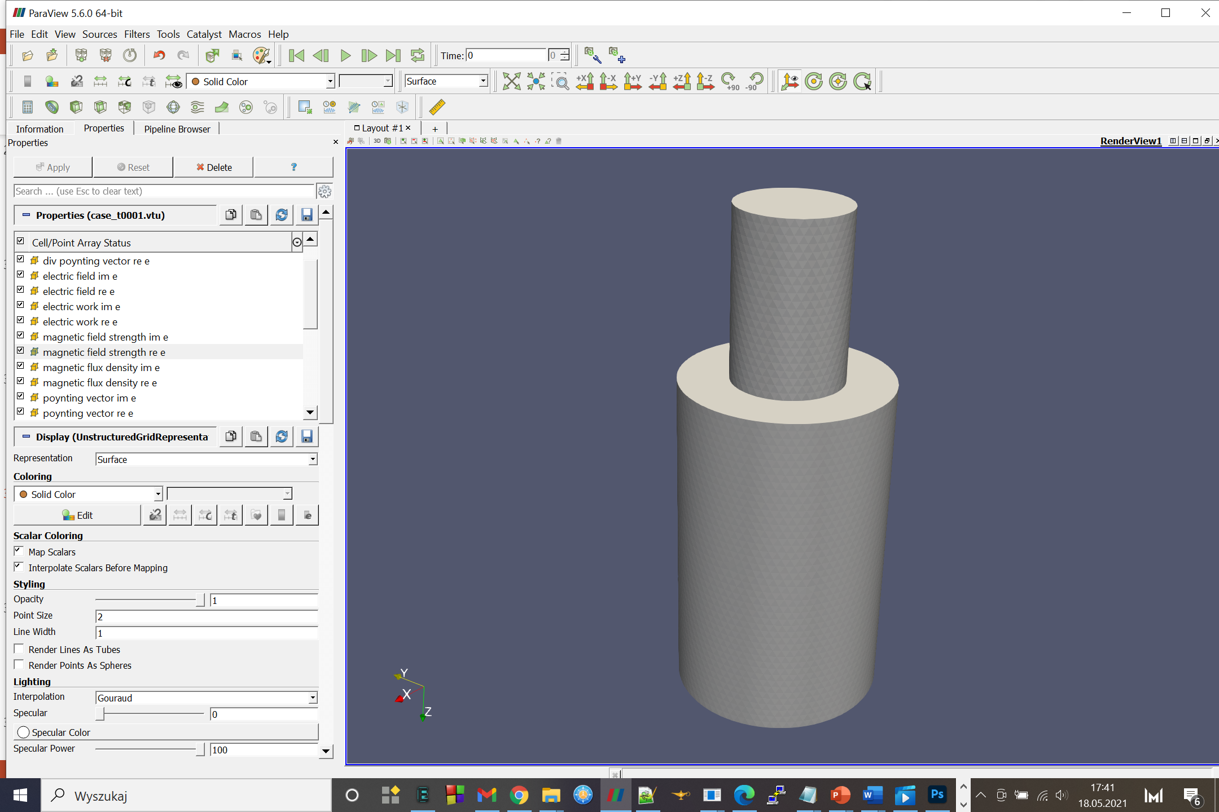
The goal: find the areas of resonance of the standing waves in the chamber

Slide 42
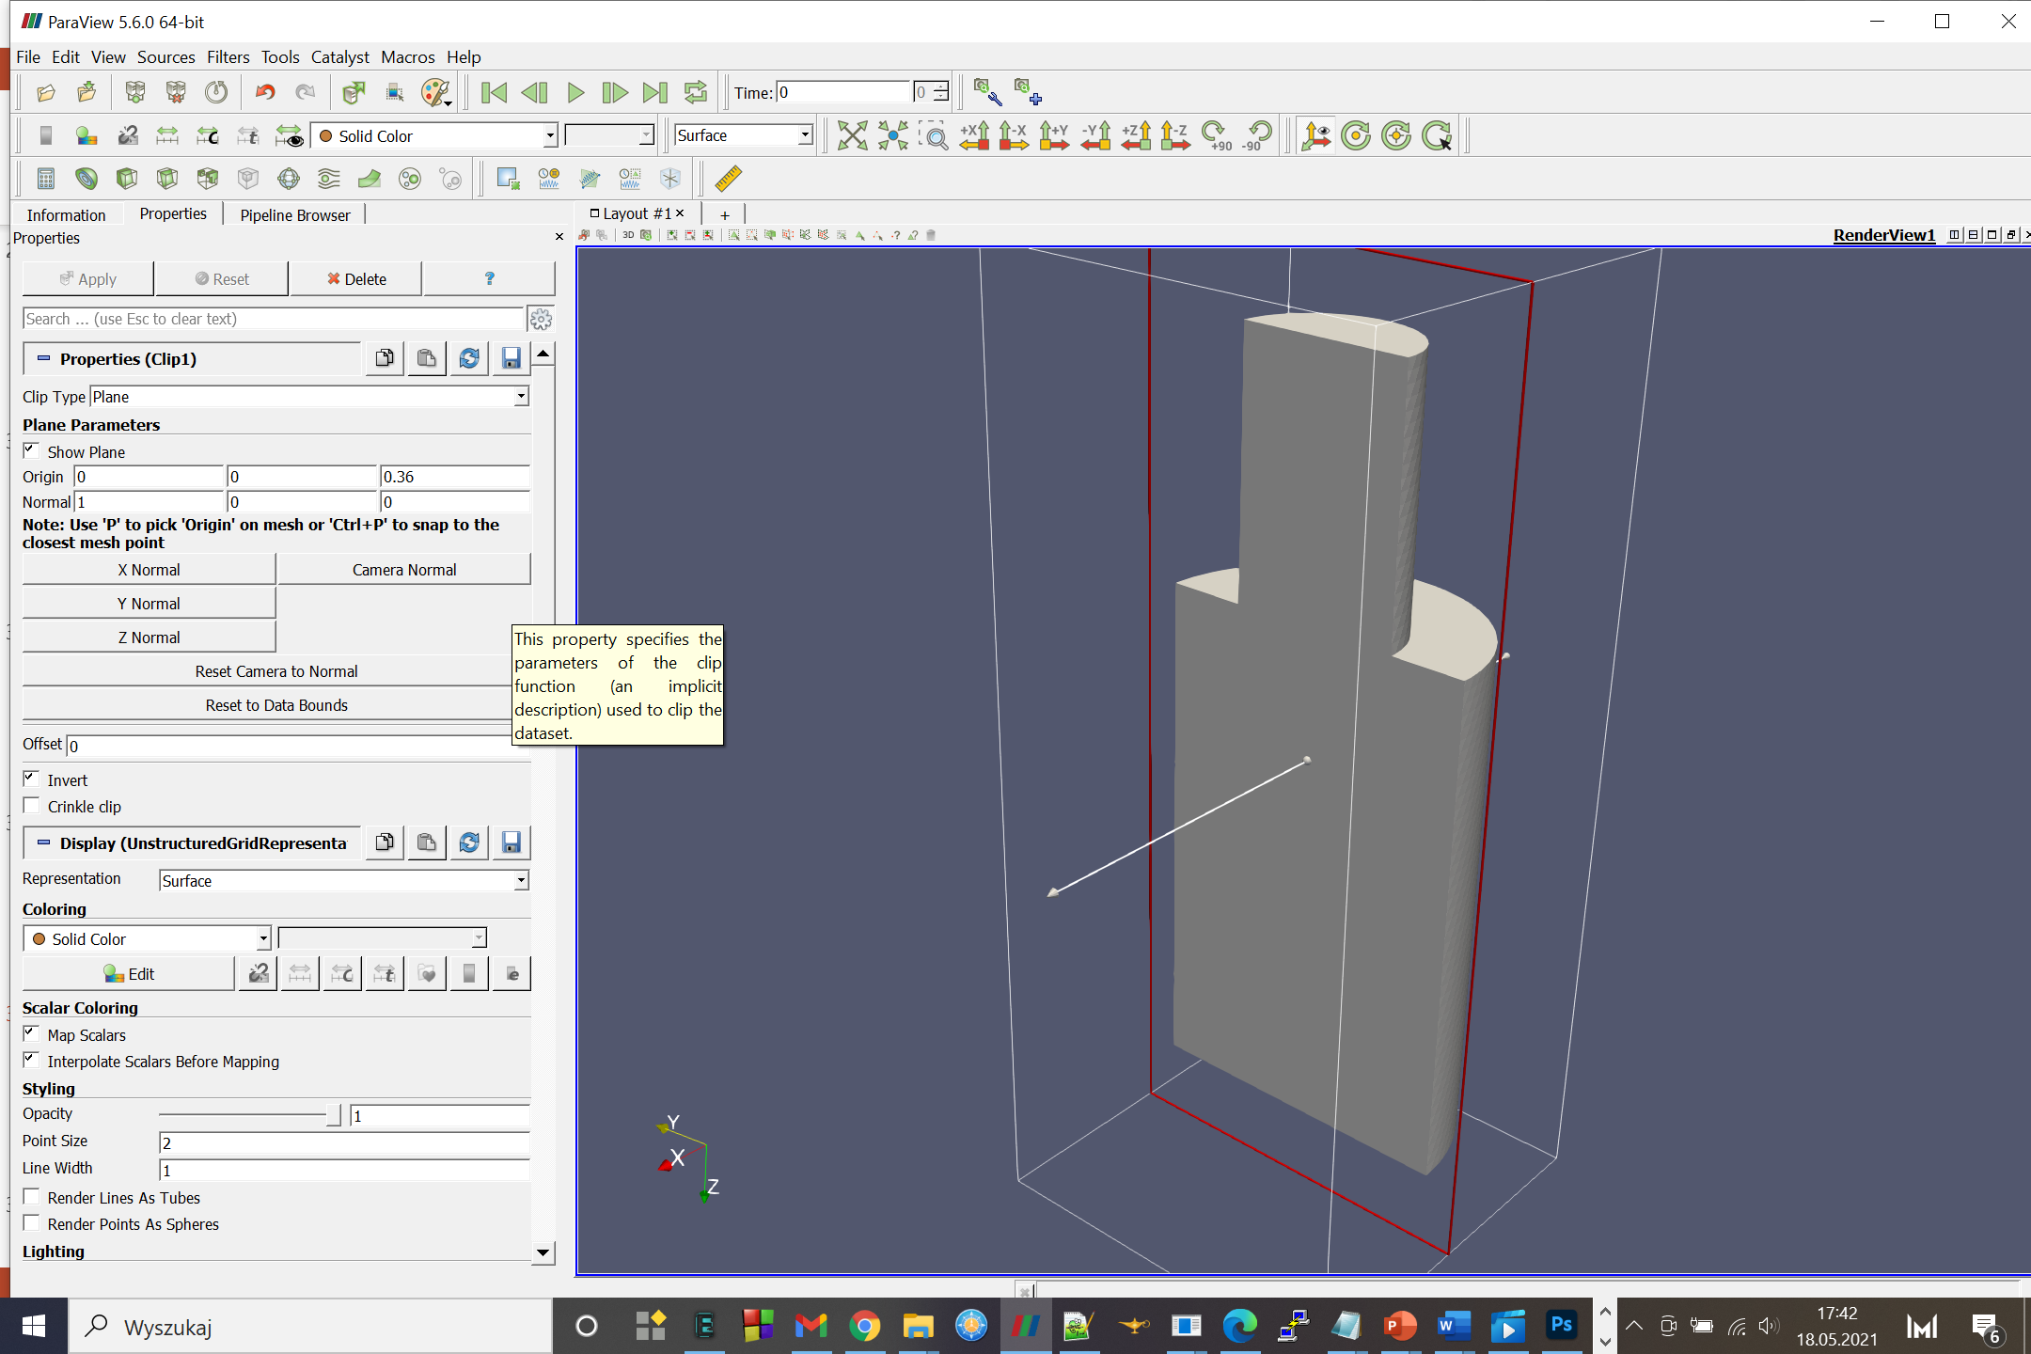

Slide 43
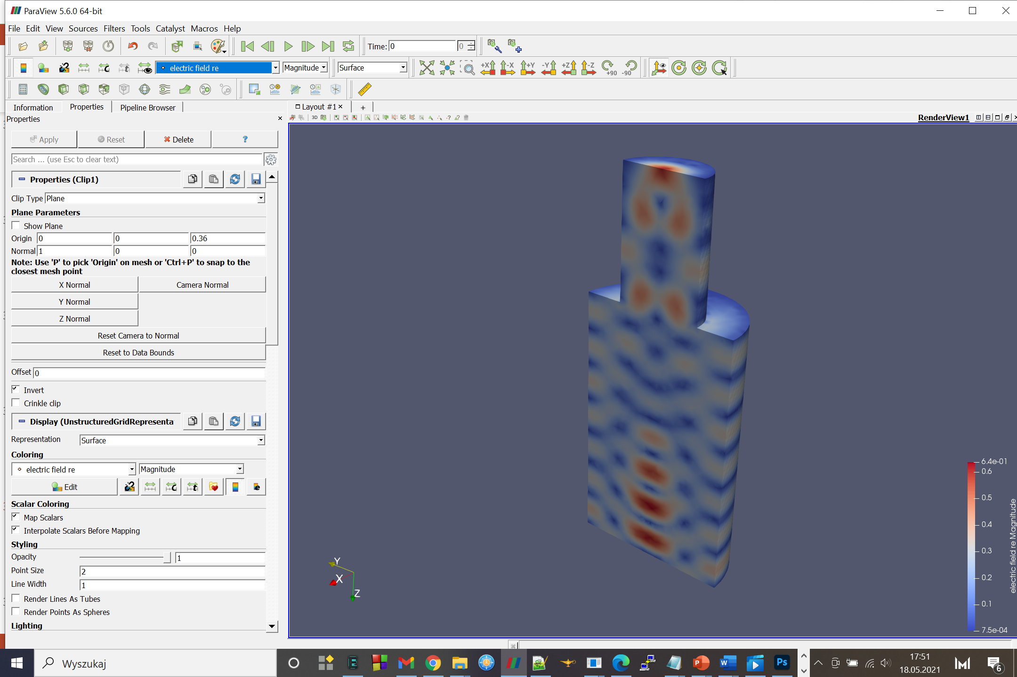

Slide 44
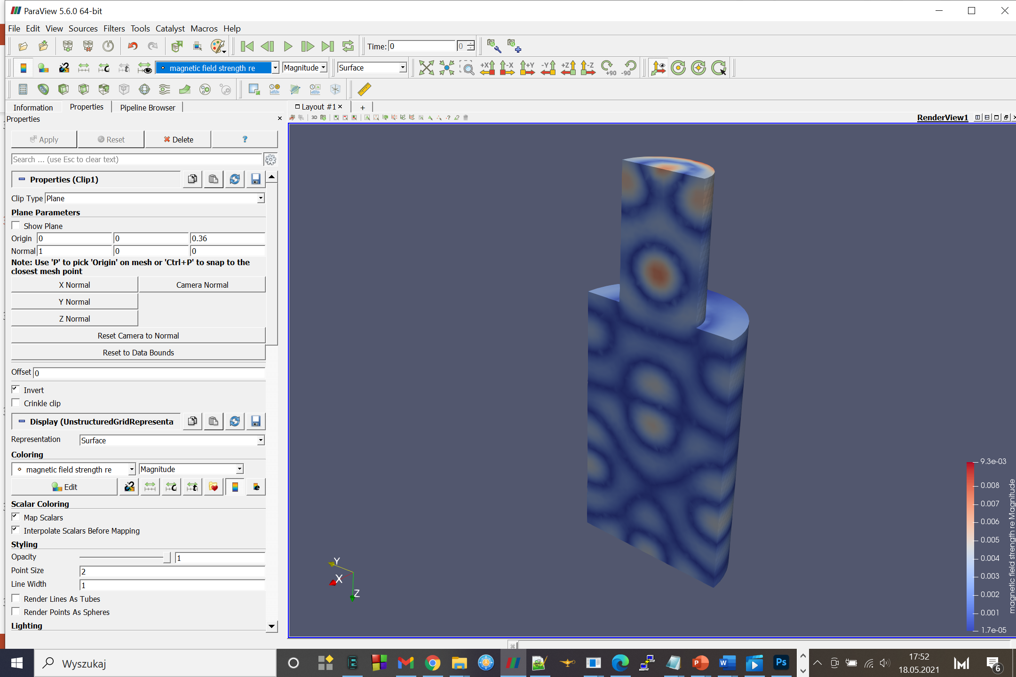

Slide 45
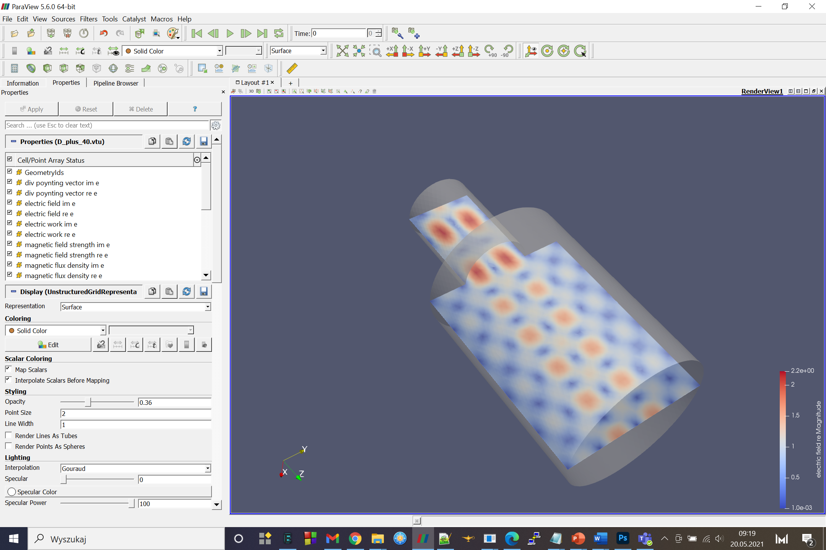

Slide 46
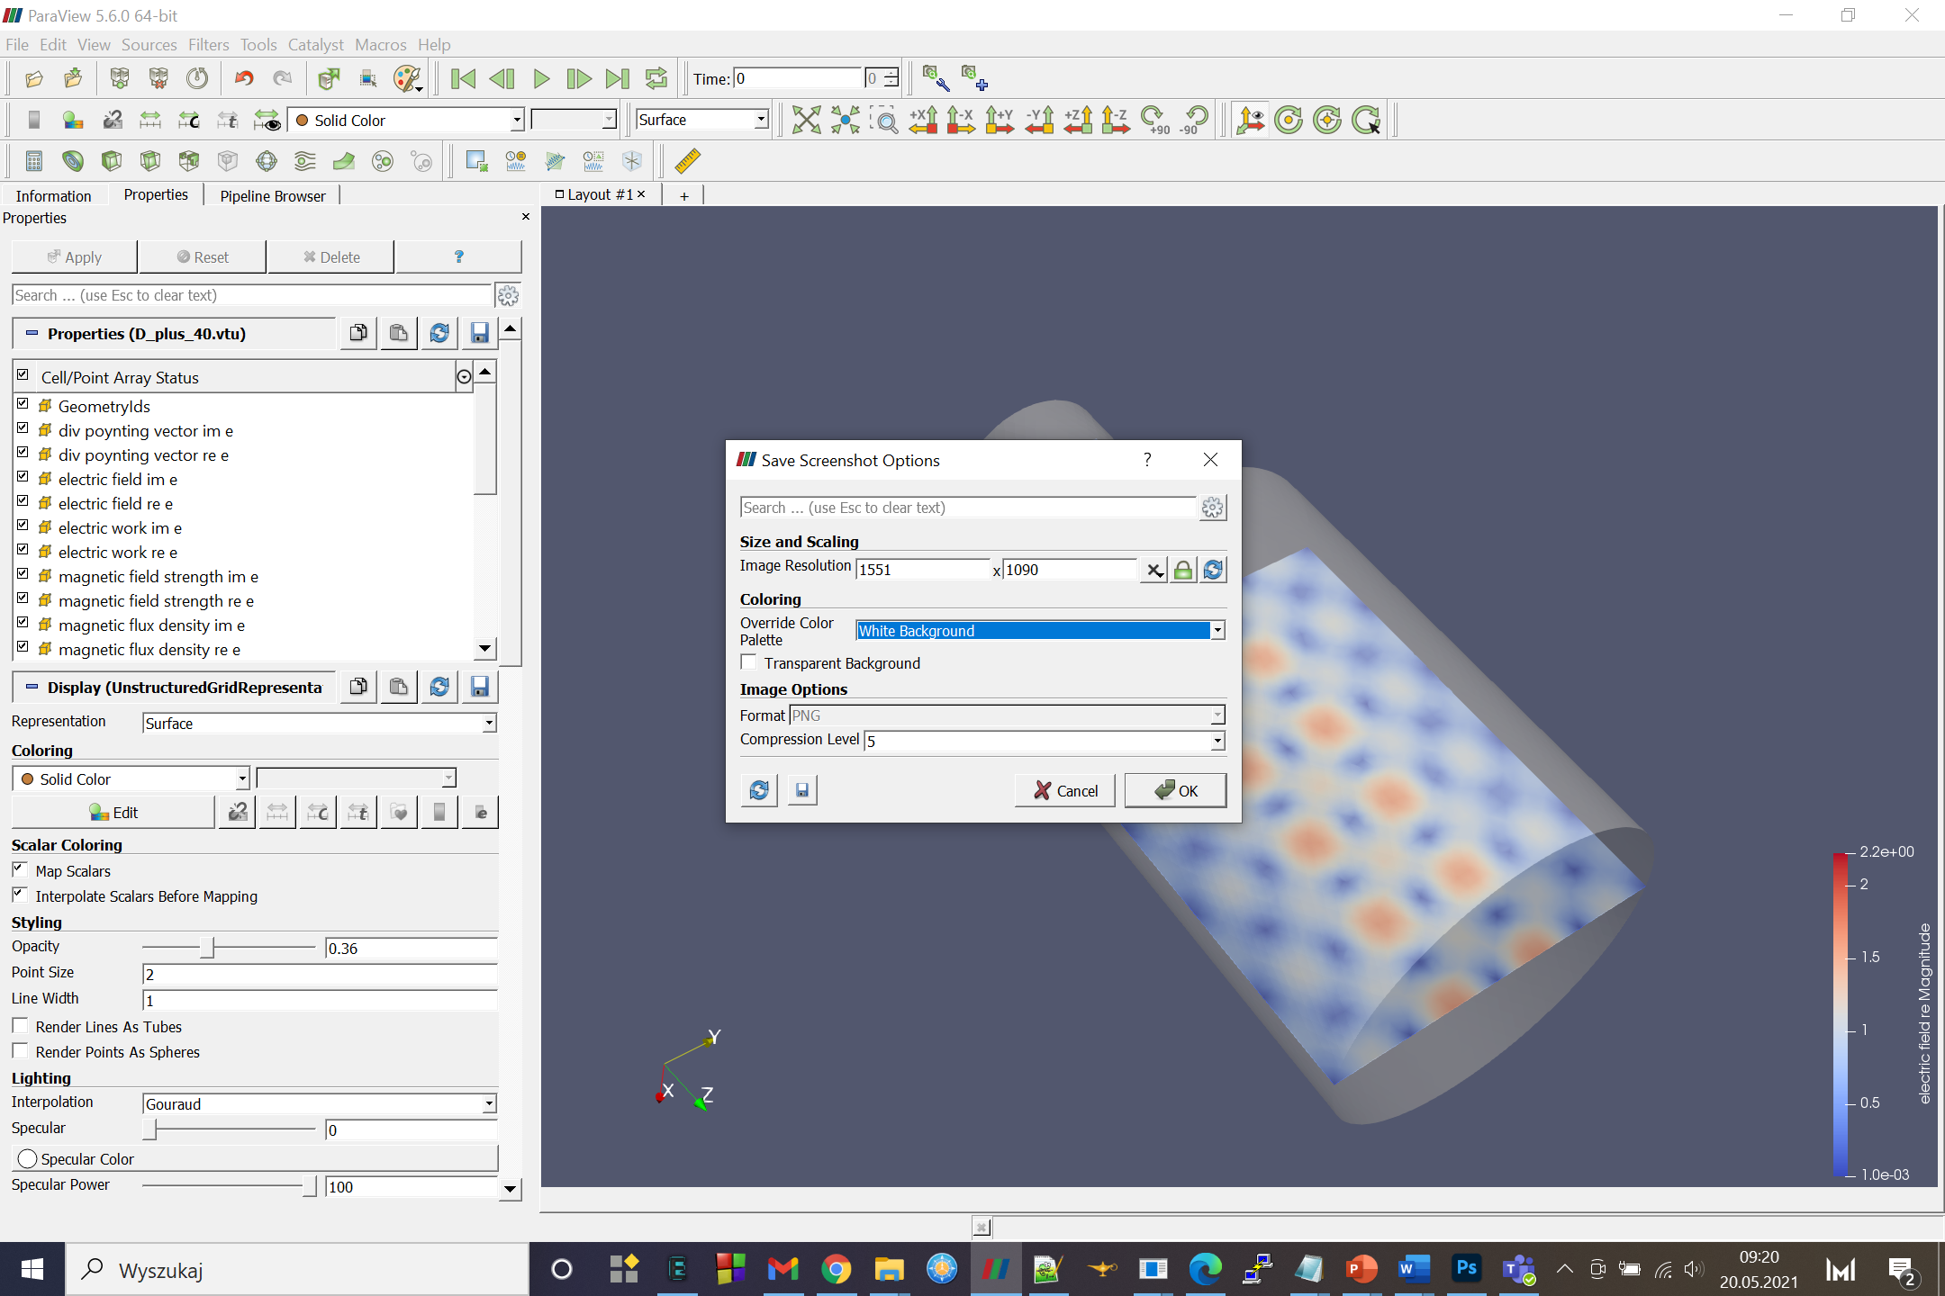

Slide 47
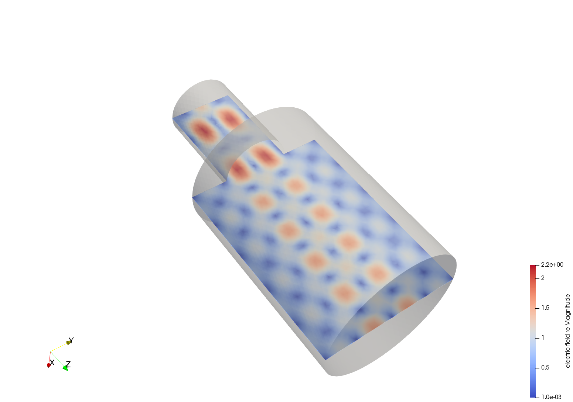

Slide 48
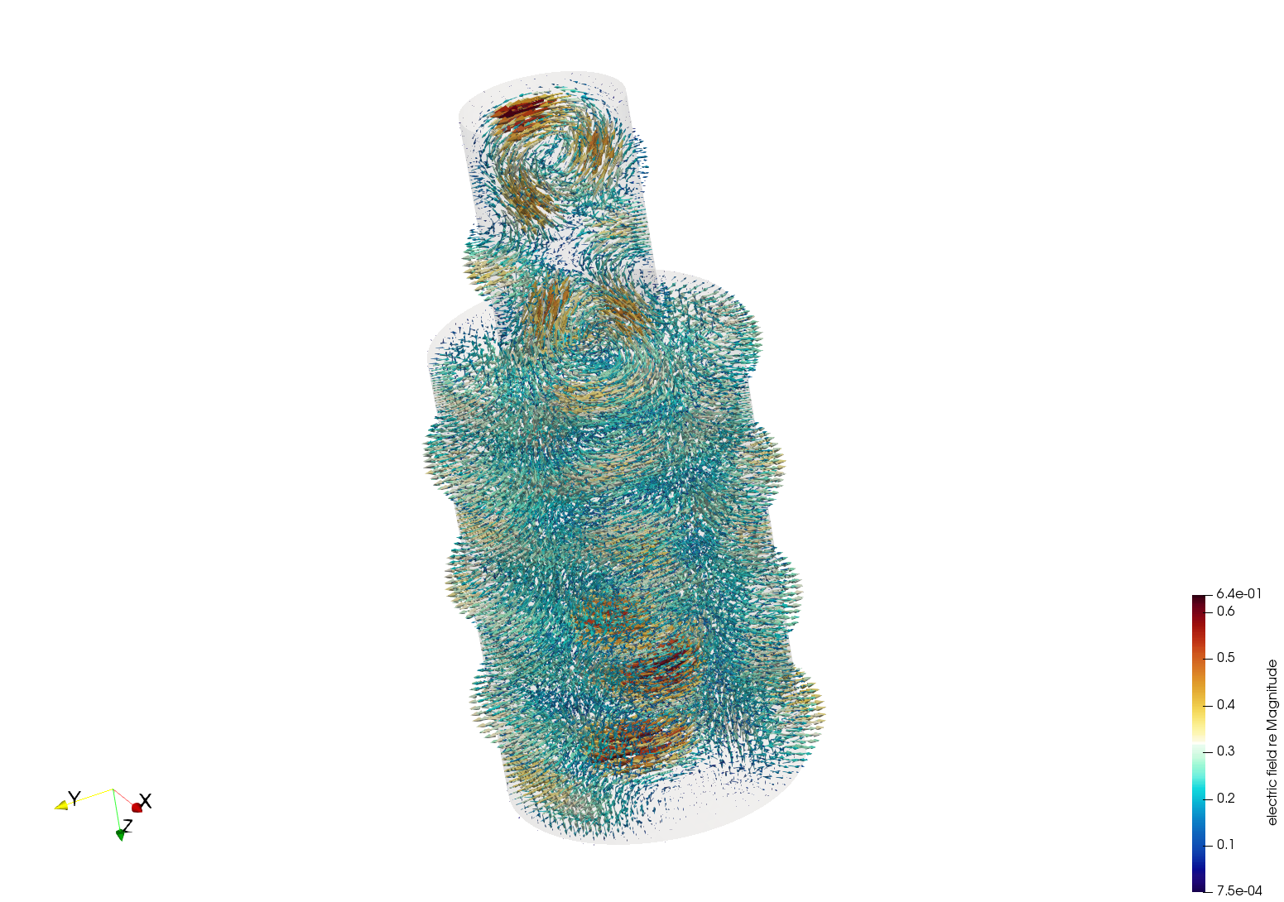

Slide 49
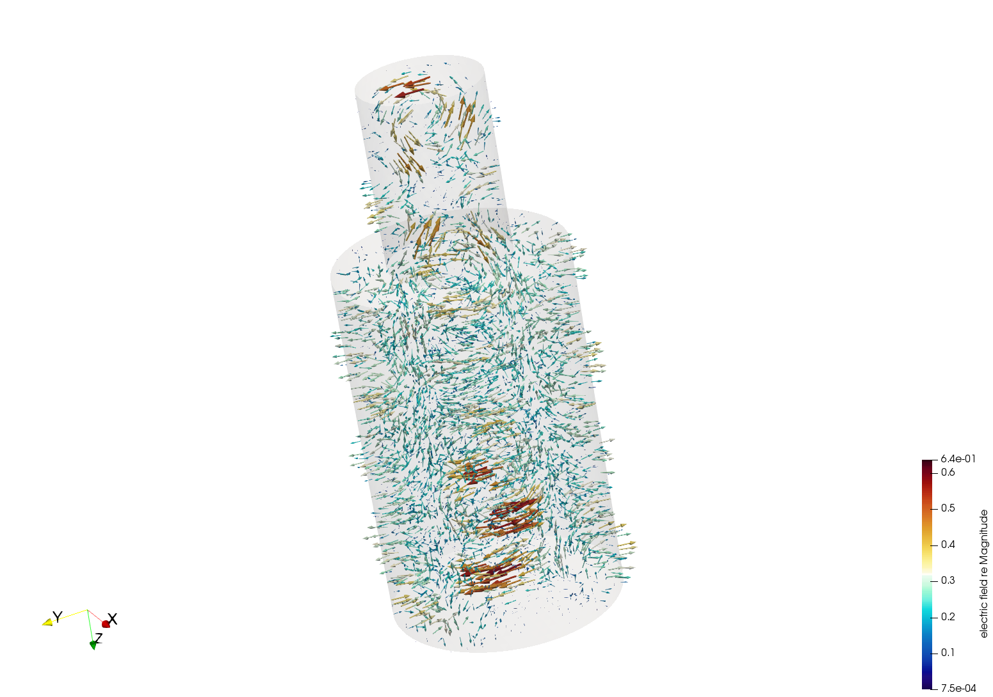

Slide 50
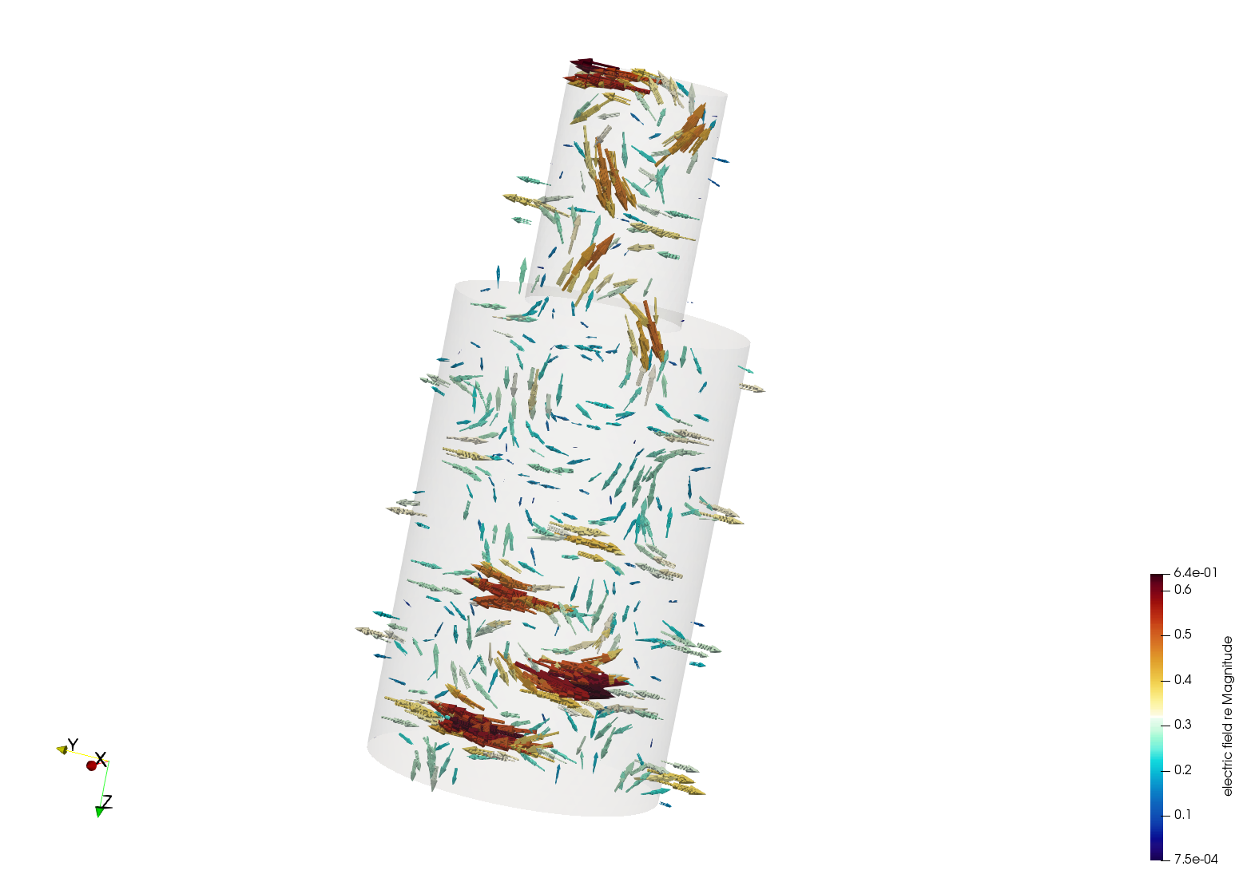

Slide 51
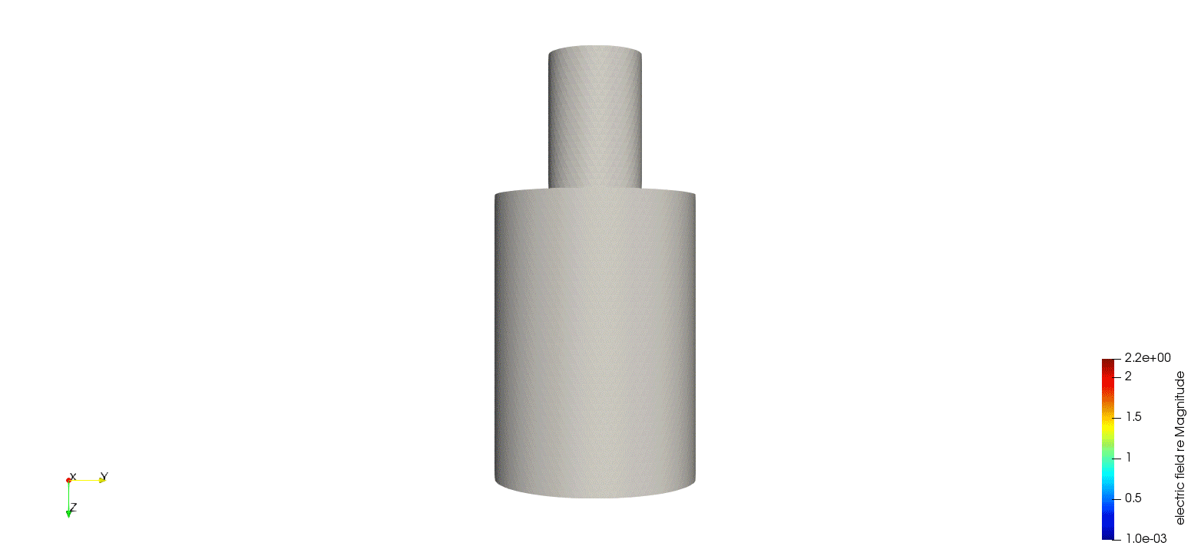

Slide 52
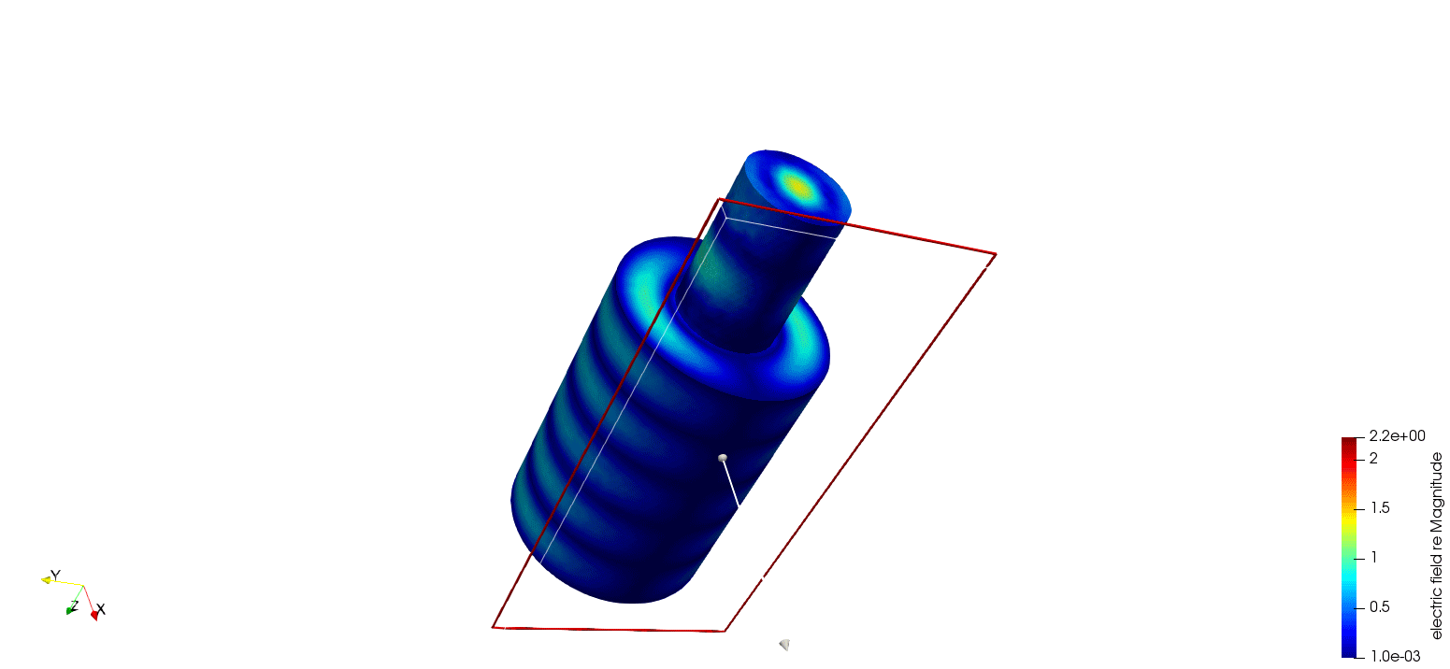

Slide 53
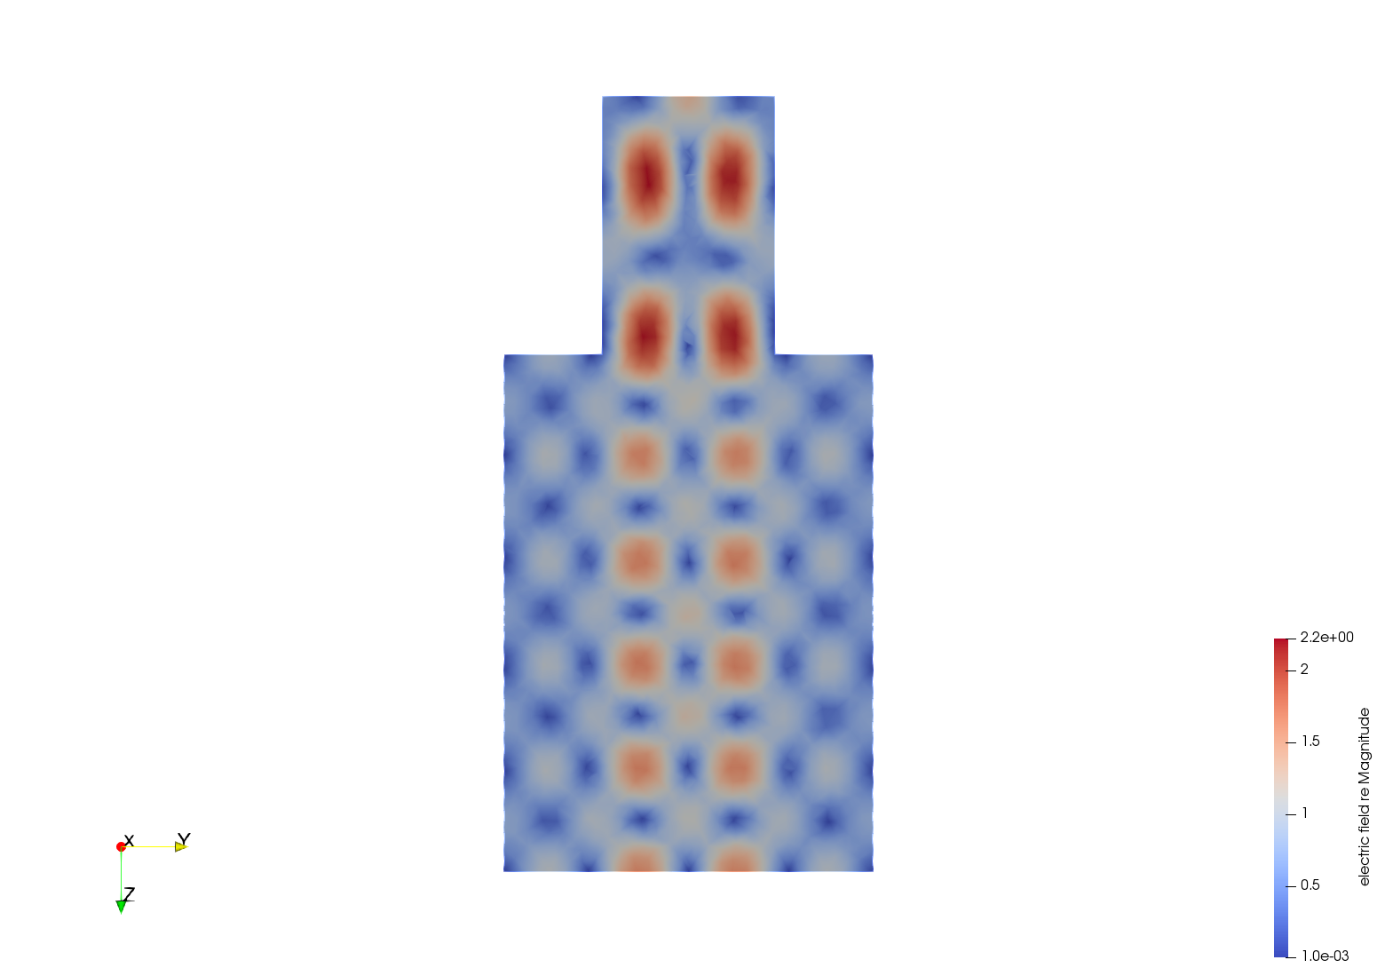
The final goal: analyse the influence of chamber dimensions on standing waves resonance
L
D

Slide 54
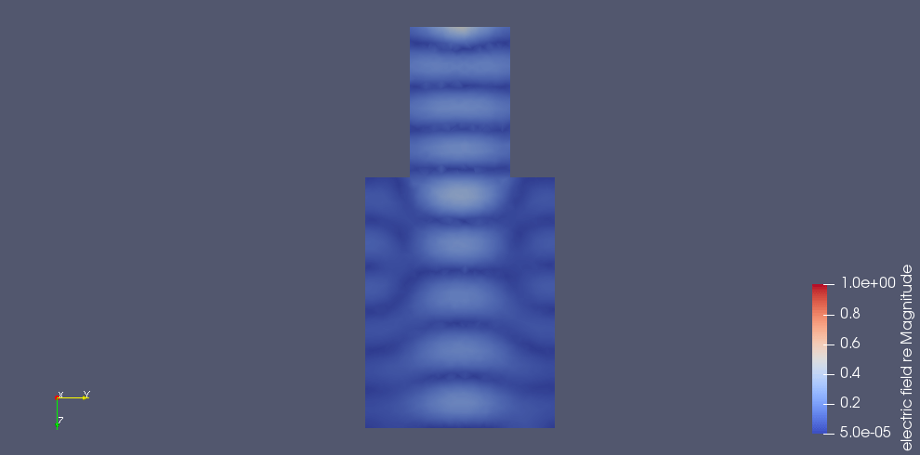
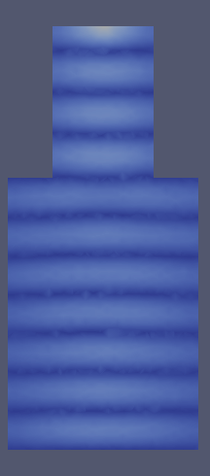
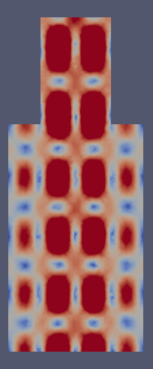
weak resonance
influence of the length change
strong resonance - standinng wave

Slide 55

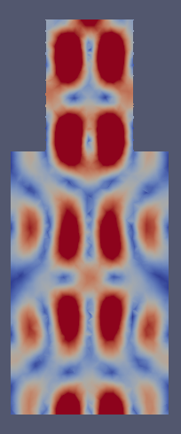
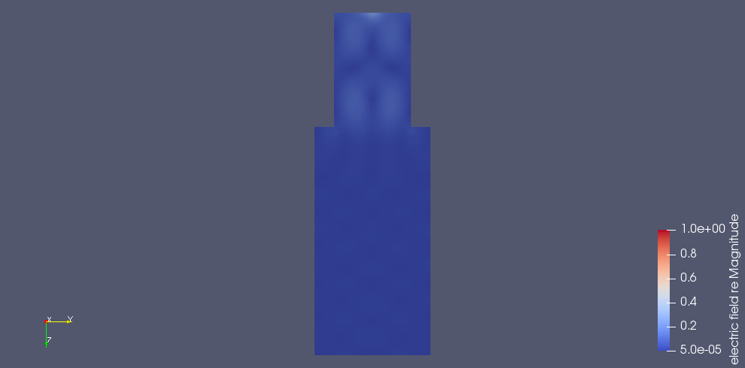
weak resonance
influence of the length change
strong resonance - standinng wave

Slide 56
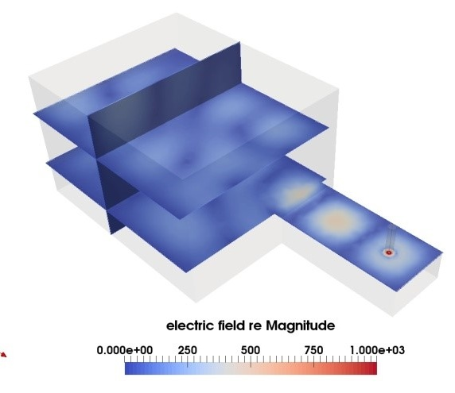
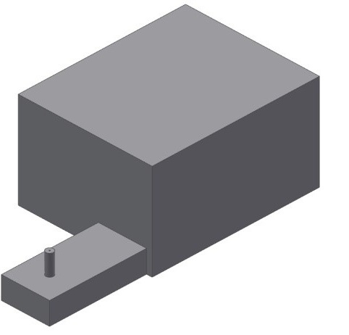
Rectangular cavity
„Microwave oven type”
3D view of rectangular cavity model
Electric field distribution, slices, rectangular cavity
with waveguide of lenght 130.5mm

Slide 57
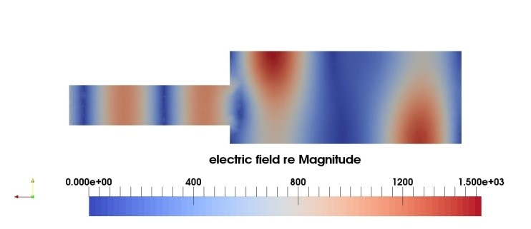



Cilindrical cavities
Electric field distribution, cavity of diameter 250mm
Electric field distribution, cavity of diameter 400mm
Electric field distribution, cavity of diameter 250mm
Electric field distribution, cavity of diameter 400mm

Slide 58


Why do we do this?
Resonant cavities
Interior of the cavitity
with sample holder

Slide 59


Prototype of microwave dryier

Slide 60

Prototype of microwave dryier
and the final product

Slide 61
Summary:
Microwave module for ELMER FEM is radical innovation.
It changed the world and the market of microwave modelling.
Microwave module for ELMER FEM enabled small and medium
companies (like RADWAG) to participate in global market of
high-tech products.
ELMER FEM is very flexible and easy to integrate in larger systems.
It is perfect environment for scientific research
– but this is another story.

Slide 62
Thank you very much for your attention.

