Slide 1
A Methodical Approach to scaling to large numbers of cores
John M Levesque
Director
Cray’s Supercomputing Center of Excellence
CSC, Finland
September 21-24, 2009

Slide 2
The steps – 1) Identify Application and Science Worthy Problem
Formulate the problem
  The problem identified should make good science sense
    No publicity stunts that are not of interest
  It should be a production style problem
    Weak scaling
      Finer grid as processors increase
      Fixed amount of work when processors increase
    Strong scaling
      Fixed problem size as processors increase
        Less and less work for each processor as processors increase
Think Bigger

Slide 3
The steps – 2) Instrument the application
Instrument the application
  Run the production case
    Run long enough that the initialization does not use > 1% of the time
    Run with normal I/O
  Use Craypat’s APA
    First gather sampling for line number profile
    Second gather instrumentation (-g mpi,io)
      Hardware counters
      MPI message passing information
      I/O information
load module
make
pat_build -O apa a.out
Execute
pat_report *.xf
pat_build –O *.apa
Execute

Slide 4
The steps – 4) Examine Results
Examine Results
  Is there load imbalance?
    Yes – fix it first – go to step 5
    No – you are lucky
  Is computation > 50% of the runtime
    Yes – go to step 6
  Is communication > 50% of the runtime
    Yes – go to step 7
  Is I/O > 50% of the runtime
    Yes – go to step 8
Always fix load imbalance first

Slide 5
The steps – 5) Application is load imbalanced
What is causing the load imbalance
  Computation
    Is decomposition appropriate?
    Would RANK_REORDER help?
  Communication
    Is decomposition appropriate?
    Would RANK_REORDER help?
    Are receives pre-posted
OpenMP may help
  Able to spread workload with less overhead
    Large amount of work to go from all-MPI to Hybrid
      Must accept challenge to OpenMP-ize large amount of code
Go back to step 3
    Re-gather statistics
Need Craypat reports
Is SYNC time due to computation?

Slide 6
Background: Virtual Memory
Modern programs operate in “virtual memory”
  Each program thinks it has all of memory to itself
  Fixed sized blocks (“pages”) vs variable sized blocks (“segments”)
Virtual Memory benefits
  Allow a program that is larger than physical memory to run
    Programmer does not have to manually create overlays
  Allow many programs to share limited physical memory
Virtual Memory problems
  Each virtual memory reference must be translated into a physical memory reference

Slide 7
Translation Speed
Translation page table is stored in main memory
  Each memory access logically takes twice as long – once to find the physical address, once to get the actual data
Use a hardware cache of least recently used addresses
  Called a Translation Lookaside Buffer or TLB

Slide 8
Performance Problem: TLB Refills
AMD Quad Core Opteron: 48 TLB entries for L1 and 512 TLB entries for L2
  Covers 2MB of physical memory
    OK if program fits (unlikely)
    Large programs accessing data from all over their virtual memory range can trigger excessive TLB misses (“thrash”)

Slide 9
Memory Alignment Issues
Cache Boundaries
Page Boundaries
Memory Banks

Slide 11
Cache Visualization
Level 1 Cache
Level 1 Cache
65536 B
1024 Lines
8192 8B Ws
16384 4B Ws
2 way Assoc
Associativity Class
32768 B
512 Lines
4096 8B Ws
8192 4B Ws
Width = 32768 Bytes
MEMORY
64*64*8 = 32768 B

Slide 12
Consider the following example

Slide 13
Cache Visualization
Level 1 Cache
Level 1 Cache
65536 B
1024 Lines
8192 8B Ws
16384 4B Ws
2 way Assoc
Associativity Class
32768 B
512 Lines
4096 8B Ws
8192 4B Ws
Width = 32768 Bytes
MEMORY
64*64*8 = 32768 B

Slide 15
Cache Visualization
Level 1 Cache
Level 1 Cache
65536 B
1024 Lines
8192 8B Ws
16384 4B Ws
2 way Assoc
Associativity Class
32768 B
512 Lines
4096 8B Ws
8192 4B Ws
Width = 32768 Bytes
MEMORY
64*64*8 = 32768 B

Slide 17
Cache Visualization
Level 1 Cache
Level 1 Cache
65536 B
1024 Lines
8192 8B Ws
16384 4B Ws
2 way Assoc
Associativity Class
32768 B
512 Lines
4096 8B Ws
8192 4B Ws
Width = 32768 Bytes
MEMORY
64*64*8 = 32768 B

Slide 19
Must be a better Way

Slide 20
Level 1 Cache
Level 1 Cache
65536 B
1024 Lines
8192 8B Ws
16384 4B Ws
2 way Assoc
Associativity Class
32768 B
512 Lines
4096 8B Ws
8192 4B Ws
Width = 32768 Bytes
MEMORY
64*64*8 = 32768 B

Slide 23
How much should be pad?
Consider the Stream Triad Benchmark
DIMENSION A(N),B(N),C(N)
DO I = 1, N
A(I)=B(I)+SCALAR*C(I)
ENDDO

Slide 24
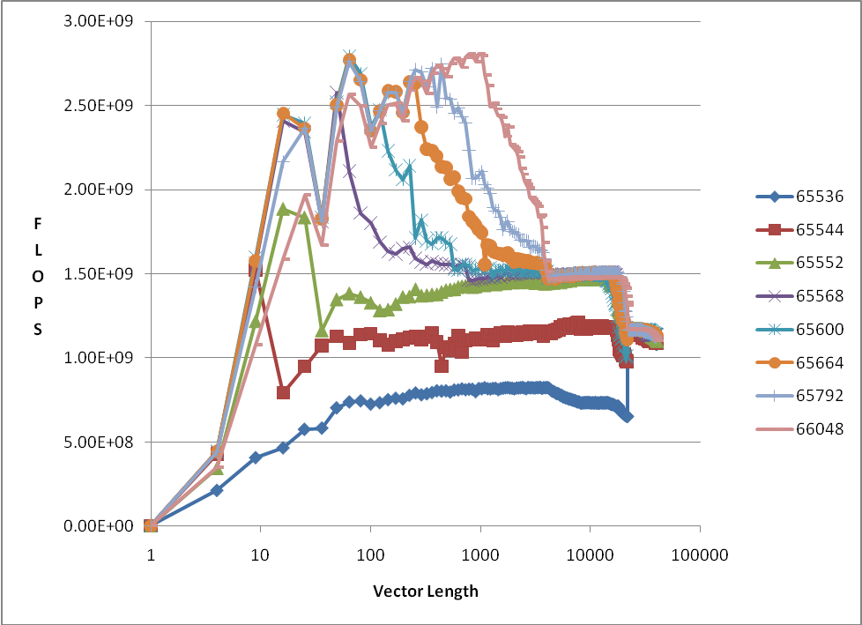
Stream for different Array sizes
N

Slide 25
Cache Memory Banks
Fetch A ====================➔
Fetch B ====================➔
Fetch C ====================➔

Slide 26
The steps – 6) Computation is Major Bottleneck
What is causing the Bottleneck?
  Computation
    Is application Vectorized
      No – vectorize it
    What library routines are being used?
  Memory Bandwidth
    What is cache utilization?
    TLB problems?
OpenMP may help
  Able to spread workload with less overhead
    Large amount of work to go from all-MPI to Hybrid
      Must accept challenge to OpenMPize large amount of code
Go back to step 3
    Re-gather statistics
Need Hardware counters
&
Compiler listing
in hand

Slide 27
The steps – 6) Communication is Major Bottleneck
What is causing the Bottleneck?
  Collectives
    MPI_ALLTOALL
    MPI_ALLREDUCE
    MPI_REDUCE
    MPI_VGATHER/MPI_VSCATTER
  Point to Point
    Are receives pre-posted
      Don’t use MPI_SENDRECV
    What are the message sizes
      Small – Combine
      Large – divide and overlap
OpenMP may help
  Able to spread workload with less overhead
    Large amount of work to go from all-MPI to Hybrid
      Must accept challenge to OpenMP-ize large amount of code
Go back to step 3
    Re-gather statistics
Look at craypat report
MPI message sizes

Slide 28
The steps – 7) I/O is Major Bottleneck
What type of I/O?
  One writer – large files
    Stripe across most OSTs
  All writers – small files
    Stripe across one OST
  MPI-I/O?
    Try using subset of writers
  Go back to step 3
    Re-gather statistics
Look at craypat report on file statistics
Look at read/write sizes

Slide 29
Questions / Comments
Thank You!
CSC, Finland
September 21-24, 2009

