Slide 1
Removing Bottlenecks to High Performance
John M Levesque
Director
Cray’s Supercomputing Center of Excellence
CSC, Finland
September 21-24, 2009

Slide 2
Outline
Vectorization issues
Cache and TLB issues
Fortran 90 constructs that perform very poorly
Message passing issues

Slide 3
Vectorization
What is vectorization?
Memory accessing issues
Data Dependency issues
IF statements
Subroutine calls

Slide 4
Vectorizable F90 Array Syntax Data is REAL*4
350 !
351 ! Initialize vertex, similarity and coordinate arrays
352 !
353 Do Index = 1, NodeCount
354 IX = MOD (Index - 1, NodesX) + 1
355 IY = ((Index - 1) / NodesX) + 1
356 CoordX (IX, IY) = Position (1) + (IX - 1) * StepX
357 CoordY (IX, IY) = Position (2) + (IY - 1) * StepY
358 JetSim (Index) = SUM (Graph (:, :, Index) * &
359 & GaborTrafo (:, :, CoordX(IX,IY), CoordY(IX,IY)))
360 VertexX (Index) = MOD (Params%Graph%RandomIndex (Index) - 1, NodesX) + 1
361 VertexY (Index) = ((Params%Graph%RandomIndex (Index) - 1) / NodesX) + 1
362 End Do
For Dual Core
Inner “loop” at line 358 is vectorizable, can used packed SSE instructions

Slide 5
–fastsse to Enable SSE Vectorization –Minfo to List Optimizations to stderr
% pgf95 -fastsse -Mipa=fast -Minfo -S graphRoutines.f90
…
localmove: 334, Loop unrolled 1 times (completely unrolled) 343, Loop unrolled 2 times (completely unrolled) 358, Generated an alternate loop for the inner loop Generated vector sse code for inner loop Generated 2 prefetch instructions for this loop Generated vector sse code for inner loop
Generated 2 prefetch instructions for this loop
…

Slide 6
Scalar SSE:
Vector SSE:
For Dual Core
.LB6_668:
# lineno: 358
movss -12(%rax),%xmm2 movss -4(%rax),%xmm3 subl $1,%edx mulss -12(%rcx),%xmm2 addss %xmm0,%xmm2 mulss -4(%rcx),%xmm3 movss -8(%rax),%xmm0 mulss -8(%rcx),%xmm0 addss %xmm0,%xmm2 movss (%rax),%xmm0 addq $16,%rax addss %xmm3,%xmm2 mulss (%rcx),%xmm0 addq $16,%rcx testl %edx,%edx addss %xmm0,%xmm2 movaps %xmm2,%xmm0 jg .LB6_625
.LB6_1245: # lineno: 358 movlps (%rdx,%rcx),%xmm2 subl $8,%eax movlps 16(%rcx,%rdx),%xmm3
prefetcht0 64(%rcx,%rsi)
prefetcht0 64(%rcx,%rdx)
movhps 8(%rcx,%rdx),%xmm2 mulps (%rsi,%rcx),%xmm2
movhps 24(%rcx,%rdx),%xmm3 addps %xmm2,%xmm0 mulps 16(%rcx,%rsi),%xmm3 addq $32,%rcx testl %eax,%eax addps %xmm3,%xmm0 jg .LB6_1245:
Facerec Scalar: 104.2 sec
Facerec Vector: 84.3 sec

Slide 7
Vectorizable C Code Fragment?
217 void func4(float *u1, float *u2, float *u3, …
…
221 for (i = -NE+1, p1 = u2-ny, p2 = n2+ny; i < nx+NE-1; i++)
222 u3[i] += clz * (p1[i] + p2[i]);
223 for (i = -NI+1, i < nx+NE-1; i++) {
224 float vdt = v[i] * dt;
225 u3[i] = 2.*u2[i]-u1[i]+vdt*vdt*u3[i];
226 }
% pgcc –fastsse –Minfo functions.c
func4:
221, Loop unrolled 4 times
221, Loop not vectorized due to data dependency
223, Loop not vectorized due to data dependency

Slide 8
Pointer Arguments Inhibit Vectorization
217 void func4(float *u1, float *u2, float *u3, …
…
221 for (i = -NE+1, p1 = u2-ny, p2 = n2+ny; i < nx+NE-1; i++)
222 u3[i] += clz * (p1[i] + p2[i]);
223 for (i = -NI+1, i < nx+NE-1; i++) {
224 float vdt = v[i] * dt;
225 u3[i] = 2.*u2[i]-u1[i]+vdt*vdt*u3[i];
226 }
% pgcc –fastsse –Msafeptr –Minfo functions.c
func4:
221, Generated vector SSE code for inner loop
Generated 3 prefetch instructions for this loop
223, Unrolled inner loop 4 times

Slide 9
C Constant Inhibits Vectorization
217 void func4(float *u1, float *u2, float *u3, …
…
221 for (i = -NE+1, p1 = u2-ny, p2 = n2+ny; i < nx+NE-1; i++)
222 u3[i] += clz * (p1[i] + p2[i]);
223 for (i = -NI+1, i < nx+NE-1; i++) {
224 float vdt = v[i] * dt;
225 u3[i] = 2.*u2[i]-u1[i]+vdt*vdt*u3[i];
226 }
% pgcc –fastsse –Msafeptr –Mfcon –Minfo functions.c
func4:
221, Generated vector SSE code for inner loop
Generated 3 prefetch instructions for this loop
223, Generated vector SSE code for inner loop
Generated 4 prefetch instructions for this loop

Slide 10
Computational Intensity
Example Loop | Computational Intensity | Bottleneck
A(:) = B(:) + C(:) | .333 | Memory
A(:) = C0 * B(:) | .5 | Memory
A(:) = B(:)*C(:)+D(:) | .5 | Memory
A(:) = B(:) * C(:) + D(:) * E(:) | .6 | Memory & Multiply
A(:) = C0 * B(:) + C(:) | .667 | Memory
A(:) = C0 + B(:) * C1 | 1.0 | Still Memory
A(:) = C0 + B(:) * (C1 + B(:) *C2) | 2.0 | Add and Multiply

Slide 11
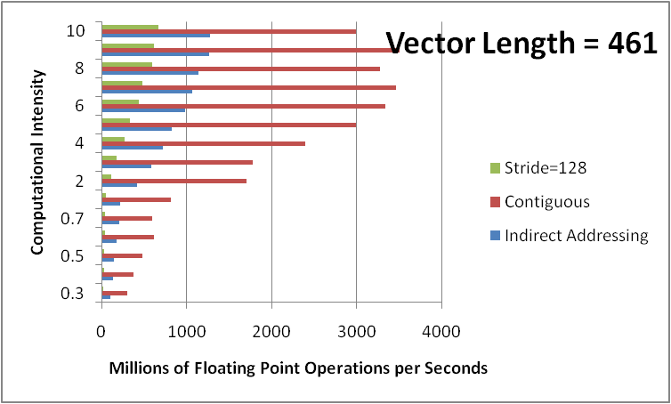
Impact of Memory accessing on Performance

Slide 12
Impact of Alignment of Variables
PARAMETER (IIDIM=100)
COMMON A(IIDIM),AF,B(IIDIM),BF,C(IIDIM) ==> run I
COMMON A(IIDIM),B(IIDIM),C(IIDIM) ==> run II
REAL*8 A,B,C,AF,BF, SCALAR
DO I=1, 100
A(I)=B(I)+SCALAR*C(I)
ENDDO
 | Run I | Run II
MFLOPS | 208 | 223

Slide 13
%%% L o o p m a r k L e g e n d %%%
Primary Loop Type Modifiers
------- ---- ---- ---------
A - Pattern matched a - vector atomic memory operation
b - blocked
C - Collapsed c - conditional and/or computed
D - Deleted f - fused
E - Cloned
I - Inlined i - interchanged
M - Multithreaded m - partitioned
P - Parallel p - partial
R - Redundant r - unrolled
s - shortloop
V - Vectorized t - array syntax temp used
w - unwound

Slide 14
Poor Memory accessing
58. 1 C THE ORIGINAL
59. 1
60. 1 2-------------< DO 41090 K = KA, KE, -1
61. 1 2 i-----------< DO 41090 J = JA, JE
62. 1 2 i iVp-------< DO 41090 I = IA, IE
63. 1 2 i iVp A(K,L,I,J) = A(K,L,I,J) - B(J,1,i,k)*A(K+1,L,I,1)
64. 1 2 i iVp * - B(J,2,i,k)*A(K+1,L,I,2) - B(J,3,i,k)*A(K+1,L,I,3)
65. 1 2 i iVp * - B(J,4,i,k)*A(K+1,L,I,4) - B(J,5,i,k)*A(K+1,L,I,5)
66. 1 2 i iVp----->>> 41090 CONTINUE
ftn-6254 ftn: VECTOR File = lp41090.f, Line = 60
A loop starting at line 60 was not vectorized because a recurrence was found on "A" at line 63.
ftn-6007 ftn: SCALAR File = lp41090.f, Line = 61
A loop starting at line 61 was interchanged with the loop starting at line 62.
ftn-6208 ftn: VECTOR File = lp41090.f, Line = 61
A loop starting at line 61 was vectorized as part of the loop starting at line 62.
ftn-6209 ftn: VECTOR File = lp41090.f, Line = 62
A loop starting at line 62 was partially vectorized.

Slide 15
Hardware counters
Time% 0.0%
Time 0.001883 secs
Calls -- 10.0 calls
PAPI_L1_DCM -- 97468 misses
PAPI_TLB_DM -- 3716 misses
PAPI_L1_DCA -- 481278 refs
PAPI_FP_OPS -- 472000 ops
User time (approx) 0 cycles 0.0%Time
Average Time per Call 0.000188 sec
CrayPat Overhead : Time 0.7%
HW FP Ops / User time -- 472000 ops
HW FP Ops / WCT --
Computational intensity -- ops/cycle 0.98 ops/ref
MFLOPS (aggregate) --M/sec
TLB utilization 129.52 refs/miss 0.253 avg uses
D1 cache hit,miss ratios 79.7% hits 20.3% misses
D1 cache utilization (M) 4.94 refs/miss 0.617 avg uses

Slide 16
Poor Memory accessing - FIXED
95. 1 C THE RESTRUCTURED
96. 1
97. 1 2-------------< DO 41091 K = KA, KE, -1
98. 1 2 3-----------< DO 41091 J = JA, JE
99. 1 2 3 Vr4-------< DO 41091 I = IA, IE
100. 1 2 3 Vr4 AA(I,K,L,J) = AA(I,K,L,J) - BB(I,J,1,K)*AA(I,K+1,L,1)
101. 1 2 3 Vr4 * - BB(I,J,2,K)*AA(I,K+1,L,2) - BB(I,J,3,K)*AA(I,K+1,L,3)
102. 1 2 3 Vr4 * - BB(I,J,4,K)*AA(I,K+1,L,4) - BB(I,J,5,K)*AA(I,K+1,L,5)
103. 1 2 3 Vr4----->>> 41091 CONTINUE
ftn-6254 ftn: VECTOR File = lp41090.f, Line = 97
A loop starting at line 97 was not vectorized because a recurrence was found on "AA" at line 100.
ftn-6294 ftn: VECTOR File = lp41090.f, Line = 98
A loop starting at line 98 was not vectorized because a better candidate was found at line 99.
ftn-6005 ftn: SCALAR File = lp41090.f, Line = 99
A loop starting at line 99 was unrolled 4 times.
ftn-6204 ftn: VECTOR File = lp41090.f, Line = 99
A loop starting at line 99 was vectorized.

Slide 17
Hardware counters for FIXED
Time% 0.0%
Time 0.000626 secs
Calls -- 10.0 calls
PAPI_L1_DCM -- 12099 misses
PAPI_TLB_DM -- 1419 misses
PAPI_L1_DCA -- 418193 refs
PAPI_FP_OPS -- 472000 ops
User time (approx) 0 cycles 0.0%Time
Average Time per Call 0.000063 sec
CrayPat Overhead : Time 2.0%
HW FP Ops / User time -- 472000 ops
HW FP Ops / WCT --
Computational intensity -- ops/cycle 1.13 ops/ref
MFLOPS (aggregate) --M/sec
TLB utilization 294.71 refs/miss 0.576 avg uses
D1 cache hit,miss ratios 97.1% hits 2.9% misses
D1 cache utilization (M) 34.56 refs/miss 4.321 avg uses

Slide 18
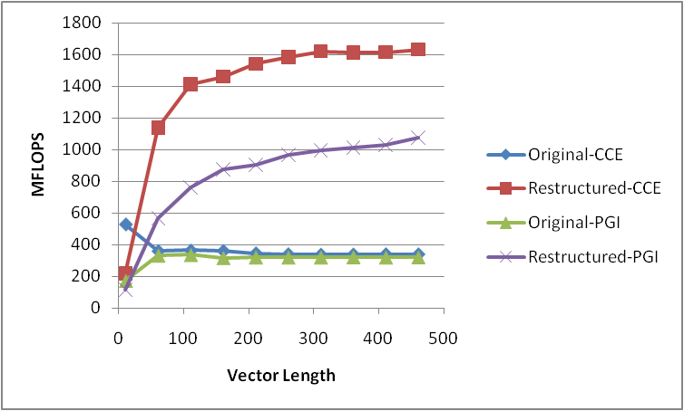
Performance Improvement for Memory Accessing

Slide 19
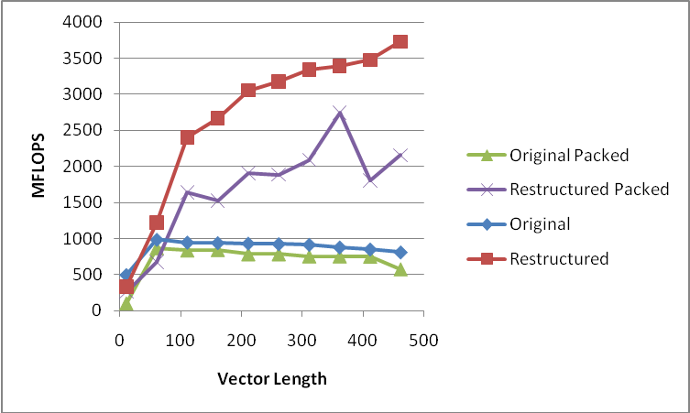
Running fully packed on the node

Slide 20
Recursive Loop
43. 1 SIA = 0.0
44. 1 J = 1
45. 1 Vpr4--< DO 43150 I = 1, N, 2
46. 1 Vpr4 SIA = SIA + A(I,MM) * B(I) + A(I+1,MM) * B(I+1)
47. 1 Vpr4 C(J) = SIA * D(J,MM)
48. 1 Vpr4 J = J + 1
49. 1 Vpr4--> 43150 CONTINUE
ftn-6005 ftn: SCALAR File = lp43150.f, Line = 45
A loop starting at line 45 was unrolled 4 times.
ftn-6209 ftn: VECTOR File = lp43150.f, Line = 45
A loop starting at line 45 was partially vectorized.

Slide 21
Recursive Loop - Restructured
68. 1 C THE RESTRUCTURED
69. 1
70. 1 J = 1
71. 1 Vr4---< DO 43151 I = 1, N+1
72. 1 Vr4 SIAT(I) = A(I,MM) * B(I)
73. 1 Vr4---> 43151 CONTINUE
74. 1
75. 1 PSIAV(1) = SIAT(1)
76. 1 r4----< DO 43152 I = 2, N+1
77. 1 r4 PSIAV(I) = PSIAV(I-1) + SIAT(I)
78. 1 r4----> 43152 CONTINUE
79. 1
80. 1 Vpr4--< DO 43153 I = 1, N, 2
81. 1 Vpr4 C(J) = PSIAV(I+1) * D(J,MM)
82. 1 Vpr4 J = J + 1
83. 1 Vpr4--> 43153 CONTINUE

Slide 22
Compiler Listing
ftn-6005 ftn: SCALAR File = lp43150.f, Line = 71
A loop starting at line 71 was unrolled 4 times.
ftn-6204 ftn: VECTOR File = lp43150.f, Line = 71
A loop starting at line 71 was vectorized.
ftn-6005 ftn: SCALAR File = lp43150.f, Line = 76
A loop starting at line 76 was unrolled 4 times.
ftn-6254 ftn: VECTOR File = lp43150.f, Line = 76
A loop starting at line 76 was not vectorized because a recurrence was found on "PSIAV" at line 77.
ftn-6005 ftn: SCALAR File = lp43150.f, Line = 80
A loop starting at line 80 was unrolled 4 times.
ftn-6209 ftn: VECTOR File = lp43150.f, Line = 80
A loop starting at line 80 was partially vectorized.

Slide 23
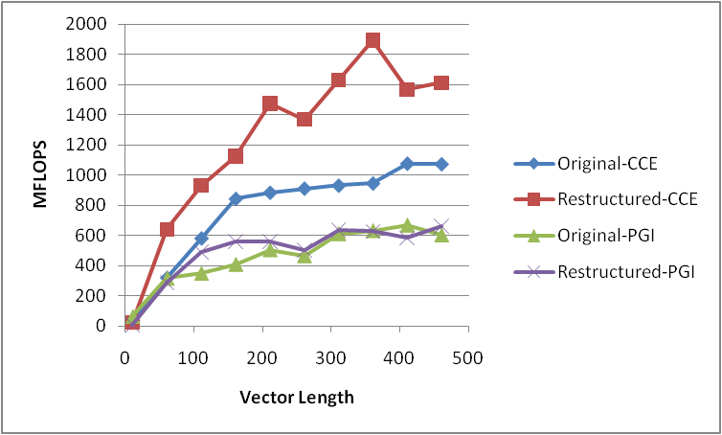
Recursive Loop Restructured

Slide 24
Multiple Loops
46. 1 2----------< DO 46011 J = 1, 4
47. 1 2 r8-------< DO 46010 I = 1, N
48. 1 2 r8 C(J,I)=0.0
49. 1 2 r8-------> 46010 CONTINUE
50. 1 2 A--------< DO 46011 K = 1,4
51. 1 2 A 4------< DO 46011 I = 1,N
52. 1 2 A 4 C(J,I) = C(J,I) + A(J,K) * B(K,I)
53. 1 2 A 4---->>> 46011 CONTINUE
ftn-6262 ftn: VECTOR File = lp46010.f, Line = 46
A loop starting at line 46 was not vectorized because it contains a call to a subroutine or function on line 52.
ftn-6332 ftn: VECTOR File = lp46010.f, Line = 47
A loop starting at line 47 was not vectorized because it does not map well onto the target architecture.
ftn-6005 ftn: SCALAR File = lp46010.f, Line = 47
A loop starting at line 47 was unrolled 8 times.
ftn-6002 ftn: SCALAR File = lp46010.f, Line = 50
A loop starting at line 50 was eliminated by optimization.
ftn-6202 ftn: VECTOR File = lp46010.f, Line = 51
A loop starting at line 51 was replaced by a library call.

Slide 25
Multiple Loops
70. 1 C THE RESTRUCTURED
71. 1
72. 1 Vp---------< DO 46012 I = 1, N
73. 1 Vp C(1,I) = A(1,1) * B(1,I) + A(1,2) * B(2,I)
74. 1 Vp * + A(1,3) * B(3,I) + A(1,4) * B(4,I)
75. 1 Vp C(2,I) = A(2,1) * B(1,I) + A(2,2) * B(2,I)
76. 1 Vp * + A(2,3) * B(3,I) + A(2,4) * B(4,I)
77. 1 Vp C(3,I) = A(3,1) * B(1,I) + A(3,2) * B(2,I)
78. 1 Vp * + A(3,3) * B(3,I) + A(3,4) * B(4,I)
79. 1 Vp C(4,I) = A(4,1) * B(1,I) + A(4,2) * B(2,I)
80. 1 Vp * + A(4,3) * B(3,I) + A(4,4) * B(4,I)
81. 1 Vp---------> 46012 CONTINUE
ftn-6209 ftn: VECTOR File = lp46010.f, Line = 72
A loop starting at line 72 was partially vectorized.

Slide 26
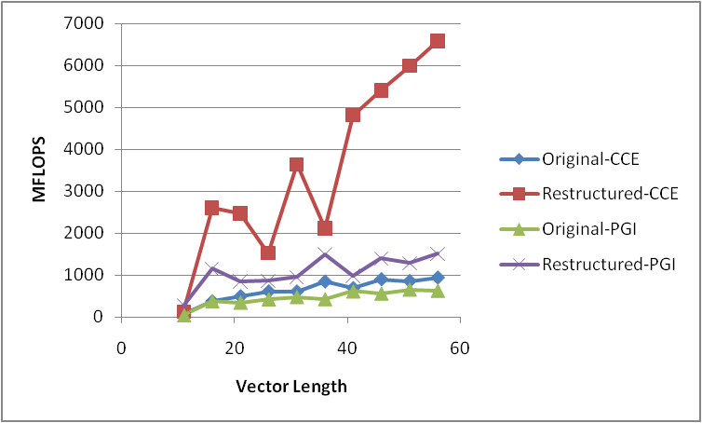
Results from restructuring

Slide 27
Loop Independent IF Statements
54. 1 b-----------< DO 47020 J = 1, JMAX
55. 1 b b---------< DO 47020 K = 1, KMAX
56. 1 b b 4-------< DO 47020 I = 1, IMAX
57. 1 b b 4 JP = J + 1
58. 1 b b 4 JR = J - 1
59. 1 b b 4 KP = K + 1
60. 1 b b 4 KR = K - 1
61. 1 b b 4 IP = I + 1
62. 1 b b 4 IR = I - 1
63. 1 b b 4 IF (J .EQ. 1) GO TO 50
64. 1 b b 4 IF( J .EQ. JMAX) GO TO 51
65. 1 b b 4 XJ = ( A(I,JP,K) - A(I,JR,K) ) * DA2
66. 1 b b 4 YJ = ( B(I,JP,K) - B(I,JR,K) ) * DA2
67. 1 b b 4 ZJ = ( C(I,JP,K) - C(I,JR,K) ) * DA2
68. 1 b b 4 GO TO 70
69. 1 b b 4 50 J1 = J + 1
70. 1 b b 4 J2 = J + 2
71. 1 b b 4 XJ = (-3. * A(I,J,K) + 4. * A(I,J1,K) - A(I,J2,K) ) * DA2
72. 1 b b 4 YJ = (-3. * B(I,J,K) + 4. * B(I,J1,K) - B(I,J2,K) ) * DA2
73. 1 b b 4 ZJ = (-3. * C(I,J,K) + 4. * C(I,J1,K) - C(I,J2,K) ) * DA2
74. 1 b b 4 GO TO 70
75. 1 b b 4 51 J1 = J - 1
76. 1 b b 4 J2 = J - 2
77. 1 b b 4 XJ = ( 3. * A(I,J,K) - 4. * A(I,J1,K) + A(I,J2,K) ) * DA2
78. 1 b b 4 YJ = ( 3. * B(I,J,K) - 4. * B(I,J1,K) + B(I,J2,K) ) * DA2
79. 1 b b 4 ZJ = ( 3. * C(I,J,K) - 4. * C(I,J1,K) + C(I,J2,K) ) * DA2
80. 1 b b 4 70 CONTINUE
81. 1 b b 4 IF (K .EQ. 1) GO TO 52
82. 1 b b 4 IF (K .EQ. KMAX) GO TO 53
83. 1 b b 4 XK = ( A(I,J,KP) - A(I,J,KR) ) * DB2
84. 1 b b 4 YK = ( B(I,J,KP) - B(I,J,KR) ) * DB2
85. 1 b b 4 ZK = ( C(I,J,KP) - C(I,J,KR) ) * DB2
86. 1 b b 4 GO TO 71

Slide 28
Loop Independent IF Statements
87. 1 b b 4 52 K1 = K + 1
88. 1 b b 4 K2 = K + 2
89. 1 b b 4 XK = (-3. * A(I,J,K) + 4. * A(I,J,K1) - A(I,J,K2) ) * DB2
90. 1 b b 4 YK = (-3. * B(I,J,K) + 4. * B(I,J,K1) - B(I,J,K2) ) * DB2
91. 1 b b 4 ZK = (-3. * C(I,J,K) + 4. * C(I,J,K1) - C(I,J,K2) ) * DB2
92. 1 b b 4 GO TO 71
93. 1 b b 4 53 K1 = K - 1
94. 1 b b 4 K2 = K - 2
95. 1 b b 4 XK = ( 3. * A(I,J,K) - 4. * A(I,J,K1) + A(I,J,K2) ) * DB2
96. 1 b b 4 YK = ( 3. * B(I,J,K) - 4. * B(I,J,K1) + B(I,J,K2) ) * DB2
97. 1 b b 4 ZK = ( 3. * C(I,J,K) - 4. * C(I,J,K1) + C(I,J,K2) ) * DB2
98. 1 b b 4 71 CONTINUE
99. 1 b b 4 IF (I .EQ. 1) GO TO 54
100. 1 b b 4 IF (I .EQ. IMAX) GO TO 55
101. 1 b b 4 XI = ( A(IP,J,K) - A(IR,J,K) ) * DC2
102. 1 b b 4 YI = ( B(IP,J,K) - B(IR,J,K) ) * DC2
103. 1 b b 4 ZI = ( C(IP,J,K) - C(IR,J,K) ) * DC2
104. 1 b b 4 GO TO 60
105. 1 b b 4 54 I1 = I + 1
106. 1 b b 4 I2 = I + 2
107. 1 b b 4 XI = (-3. * A(I,J,K) + 4. * A(I1,J,K) - A(I2,J,K) ) * DC2
108. 1 b b 4 YI = (-3. * B(I,J,K) + 4. * B(I1,J,K) - B(I2,J,K) ) * DC2
109. 1 b b 4 ZI = (-3. * C(I,J,K) + 4. * C(I1,J,K) - C(I2,J,K) ) * DC2
110. 1 b b 4 GO TO 60
111. 1 b b 4 55 I1 = I - 1
112. 1 b b 4 I2 = I - 2
113. 1 b b 4 XI = ( 3. * A(I,J,K) - 4. * A(I1,J,K) + A(I2,J,K) ) * DC2
114. 1 b b 4 YI = ( 3. * B(I,J,K) - 4. * B(I1,J,K) + B(I2,J,K) ) * DC2
115. 1 b b 4 ZI = ( 3. * C(I,J,K) - 4. * C(I1,J,K) + C(I2,J,K) ) * DC2
116. 1 b b 4 60 CONTINUE
117. 1 b b 4 DINV = XJ * YK * ZI + YJ * ZK * XI + ZJ * XK * YI
118. 1 b b 4 * - XJ * ZK * YI - YJ * XK * ZI - ZJ * YK * XI
119. 1 b b 4 D(I,J,K) = 1. / (DINV + 1.E-20)
120. 1 b b 4----->>> 47020 CONTINUE

Slide 29
Compiler Listing
ftn-6294 ftn: VECTOR File = lp47020.f, Line = 54
A loop starting at line 54 was not vectorized because a better candidate was found at line 56.
ftn-6049 ftn: SCALAR File = lp47020.f, Line = 54
A loop starting at line 54 was blocked with block size 16.
ftn-6294 ftn: VECTOR File = lp47020.f, Line = 55
A loop starting at line 55 was not vectorized because a better candidate was found at line 56.
ftn-6049 ftn: SCALAR File = lp47020.f, Line = 55
A loop starting at line 55 was blocked with block size 2.
ftn-6270 ftn: VECTOR File = lp47020.f, Line = 56
A loop starting at line 56 was not vectorized because it contains conditional code which is more
efficient if executed in scalar mode.
ftn-6010 ftn: SCALAR File = lp47020.f, Line = 119
A divide was turned into a multiply by a reciprocal

Slide 30
Restructured
141. 1 C THE RESTRUCTURED
142. 1
143. 1 2-----------< DO 47029 J = 1, JMAX
144. 1 2 3---------< DO 47029 K = 1, KMAX
145. 1 2 3
146. 1 2 3 IF(J.EQ.1)THEN
147. 1 2 3
148. 1 2 3 J1 = 2
149. 1 2 3 J2 = 3
150. 1 2 3 Vr4-----< DO 47021 I = 1, IMAX
151. 1 2 3 Vr4 VAJ(I) = (-3. * A(I,J,K) + 4. * A(I,J1,K) - A(I,J2,K) ) * DA2
152. 1 2 3 Vr4 VBJ(I) = (-3. * B(I,J,K) + 4. * B(I,J1,K) - B(I,J2,K) ) * DA2
153. 1 2 3 Vr4 VCJ(I) = (-3. * C(I,J,K) + 4. * C(I,J1,K) - C(I,J2,K) ) * DA2
154. 1 2 3 Vr4-----> 47021 CONTINUE
155. 1 2 3
156. 1 2 3 ELSE IF(J.NE.JMAX) THEN
157. 1 2 3
158. 1 2 3 JP = J+1
159. 1 2 3 JR = J-1
160. 1 2 3 Vr4-----< DO 47022 I = 1, IMAX
161. 1 2 3 Vr4 VAJ(I) = ( A(I,JP,K) - A(I,JR,K) ) * DA2
162. 1 2 3 Vr4 VBJ(I) = ( B(I,JP,K) - B(I,JR,K) ) * DA2
163. 1 2 3 Vr4 VCJ(I) = ( C(I,JP,K) - C(I,JR,K) ) * DA2
164. 1 2 3 Vr4-----> 47022 CONTINUE
165. 1 2 3
166. 1 2 3 ELSE
167. 1 2 3
168. 1 2 3 J1 = JMAX-1
169. 1 2 3 J2 = JMAX-2
170. 1 2 3 Vr4-----< DO 47023 I = 1, IMAX
171. 1 2 3 Vr4 VAJ(I) = ( 3. * A(I,J,K) - 4. * A(I,J1,K) + A(I,J2,K) ) * DA2
172. 1 2 3 Vr4 VBJ(I) = ( 3. * B(I,J,K) - 4. * B(I,J1,K) + B(I,J2,K) ) * DA2
173. 1 2 3 Vr4 VCJ(I) = ( 3. * C(I,J,K) - 4. * C(I,J1,K) + C(I,J2,K) ) * DA2
174. 1 2 3 Vr4-----> 47023 CONTINUE
175. 1 2 3
176. 1 2 3 ENDIF
177. 1 2 3

Slide 31
Restructured
178. 1 2 3 IF(K.EQ.1) THEN
179. 1 2 3
180. 1 2 3 K1 = 2
181. 1 2 3 K2 = 3
182. 1 2 3 Vr4-----< DO 47024 I = 1, IMAX
183. 1 2 3 Vr4 VAK(I) = (-3. * A(I,J,K) + 4. * A(I,J,K1) - A(I,J,K2) ) * DB2
184. 1 2 3 Vr4 VBK(I) = (-3. * B(I,J,K) + 4. * B(I,J,K1) - B(I,J,K2) ) * DB2
185. 1 2 3 Vr4 VCK(I) = (-3. * C(I,J,K) + 4. * C(I,J,K1) - C(I,J,K2) ) * DB2
186. 1 2 3 Vr4-----> 47024 CONTINUE
187. 1 2 3
188. 1 2 3 ELSE IF(K.NE.KMAX)THEN
189. 1 2 3
190. 1 2 3 KP = K + 1
191. 1 2 3 KR = K - 1
192. 1 2 3 Vr4-----< DO 47025 I = 1, IMAX
193. 1 2 3 Vr4 VAK(I) = ( A(I,J,KP) - A(I,J,KR) ) * DB2
194. 1 2 3 Vr4 VBK(I) = ( B(I,J,KP) - B(I,J,KR) ) * DB2
195. 1 2 3 Vr4 VCK(I) = ( C(I,J,KP) - C(I,J,KR) ) * DB2
196. 1 2 3 Vr4-----> 47025 CONTINUE
197. 1 2 3
198. 1 2 3 ELSE
199. 1 2 3
200. 1 2 3 K1 = KMAX - 1
201. 1 2 3 K2 = KMAX - 2
202. 1 2 3 Vr4-----< DO 47026 I = 1, IMAX
203. 1 2 3 Vr4 VAK(I) = ( 3. * A(I,J,K) - 4. * A(I,J,K1) + A(I,J,K2) ) * DB2
204. 1 2 3 Vr4 VBK(I) = ( 3. * B(I,J,K) - 4. * B(I,J,K1) + B(I,J,K2) ) * DB2
205. 1 2 3 Vr4 VCK(I) = ( 3. * C(I,J,K) - 4. * C(I,J,K1) + C(I,J,K2) ) * DB2
206. 1 2 3 Vr4-----> 47026 CONTINUE
207. 1 2 3 ENDIF
208. 1 2 3
209. 1 2 3 I = 1
210. 1 2 3 I1 = 2
211. 1 2 3 I2 = 3
212. 1 2 3 VAI(I) = (-3. * A(I,J,K) + 4. * A(I1,J,K) - A(I2,J,K) ) * DC2
213. 1 2 3 VBI(I) = (-3. * B(I,J,K) + 4. * B(I1,J,K) - B(I2,J,K) ) * DC2
214. 1 2 3 VCI(I) = (-3. * C(I,J,K) + 4. * C(I1,J,K) - C(I2,J,K) ) * DC2
215. 1 2 3

Slide 32
Restructured
216. 1 2 3 Vr4-----< DO 47027 I = 2, IMAX-1
217. 1 2 3 Vr4 IP = I + 1
218. 1 2 3 Vr4 IR = I - 1
219. 1 2 3 Vr4 VAI(I) = ( A(IP,J,K) - A(IR,J,K) ) * DC2
220. 1 2 3 Vr4 VBI(I) = ( B(IP,J,K) - B(IR,J,K) ) * DC2
221. 1 2 3 Vr4 VCI(I) = ( C(IP,J,K) - C(IR,J,K) ) * DC2
222. 1 2 3 Vr4-----> 47027 CONTINUE
223. 1 2 3
224. 1 2 3 I = IMAX
225. 1 2 3 I1 = IMAX - 1
226. 1 2 3 I2 = IMAX - 2
227. 1 2 3 VAI(I) = ( 3. * A(I,J,K) - 4. * A(I1,J,K) + A(I2,J,K) ) * DC2
228. 1 2 3 VBI(I) = ( 3. * B(I,J,K) - 4. * B(I1,J,K) + B(I2,J,K) ) * DC2
229. 1 2 3 VCI(I) = ( 3. * C(I,J,K) - 4. * C(I1,J,K) + C(I2,J,K) ) * DC2
230. 1 2 3
231. 1 2 3 Vr4-----< DO 47028 I = 1, IMAX
232. 1 2 3 Vr4 DINV = VAJ(I) * VBK(I) * VCI(I) + VBJ(I) * VCK(I) * VAI(I)
233. 1 2 3 Vr4 1 + VCJ(I) * VAK(I) * VBI(I) - VAJ(I) * VCK(I) * VBI(I)
234. 1 2 3 Vr4 2 - VBJ(I) * VAK(I) * VCI(I) - VCJ(I) * VBK(I) * VAI(I)
235. 1 2 3 Vr4 D(I,J,K) = 1. / (DINV + 1.E-20)
236. 1 2 3 Vr4-----> 47028 CONTINUE
237. 1 2 3-------->> 47029 CONTINUE

Slide 33
Compiler listing
ftn-6289 ftn: VECTOR File = lp47020.f, Line = 143
A loop starting at line 143 was not vectorized because a recurrence was found on "VAJ" between lines 151 and 232.
ftn-6289 ftn: VECTOR File = lp47020.f, Line = 144
A loop starting at line 144 was not vectorized because a recurrence was found on "VAI" between lines 212 and 232.
ftn-6005 ftn: SCALAR File = lp47020.f, Line = 150
A loop starting at line 150 was unrolled 4 times.
ftn-6204 ftn: VECTOR File = lp47020.f, Line = 150
A loop starting at line 150 was vectorized.
ftn-6005 ftn: SCALAR File = lp47020.f, Line = 160
A loop starting at line 160 was unrolled 4 times.
ftn-6204 ftn: VECTOR File = lp47020.f, Line = 160
A loop starting at line 160 was vectorized.
ftn-6005 ftn: SCALAR File = lp47020.f, Line = 170
A loop starting at line 170 was unrolled 4 times.
ftn-6204 ftn: VECTOR File = lp47020.f, Line = 170
A loop starting at line 170 was vectorized.
ftn-6005 ftn: SCALAR File = lp47020.f, Line = 182
A loop starting at line 182 was unrolled 4 times.
ftn-6204 ftn: VECTOR File = lp47020.f, Line = 182
A loop starting at line 182 was vectorized.
ftn-6005 ftn: SCALAR File = lp47020.f, Line = 192
A loop starting at line 192 was unrolled 4 times.
ftn-6204 ftn: VECTOR File = lp47020.f, Line = 192
A loop starting at line 192 was vectorized.

Slide 34
Compiler listing
ftn-6005 ftn: SCALAR File = lp47020.f, Line = 202
A loop starting at line 202 was unrolled 4 times.
ftn-6204 ftn: VECTOR File = lp47020.f, Line = 202
A loop starting at line 202 was vectorized.
ftn-6005 ftn: SCALAR File = lp47020.f, Line = 216
A loop starting at line 216 was unrolled 4 times.
ftn-6204 ftn: VECTOR File = lp47020.f, Line = 216
A loop starting at line 216 was vectorized.
ftn-6005 ftn: SCALAR File = lp47020.f, Line = 231
A loop starting at line 231 was unrolled 4 times.
ftn-6204 ftn: VECTOR File = lp47020.f, Line = 231
A loop starting at line 231 was vectorized.
ftn-6010 ftn: SCALAR File = lp47020.f, Line = 235
A divide was turned into a multiply by a reciprocal

Slide 35
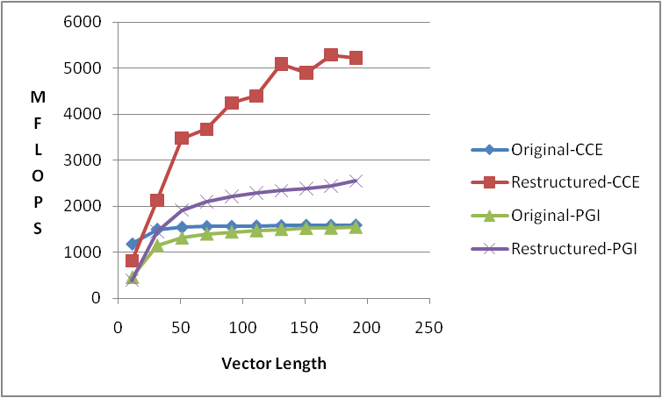
Performance of restructuring

Slide 36
39. 1 C THE ORIGINAL
40. 1
41. 1 2-----< DO 48020 I = 1, N
42. 1 2 A(I) = B(I) * FUNC (D(I)) + C(I)
43. 1 2-----> 48020 CONTINUE
ftn-6287 ftn: VECTOR File = lp48020.f, Line = 41
A loop starting at line 41 was not vectorized because it contains a call to function "FUNC" on line 42.

Slide 37
Using a statement function
3. C
4. CHANGE THE DIMENSIONS OF ARRAYS
5. COMMON A(IIDIM),B(IIDIM),C(IIDIM),D(IIDIM),E(IIDIM)
6. C
7. DIMENSION TIME(2)
8. COMMON/EPSIL/EPSILON
9. C
10. FUNCX (X) = X**2 + 2.0 / X
o o o
63. 1 Vpr4--< DO 48021 I = 1, N
64. 1 Vpr4 A(I) = B(I) * FUNCX (D(I)) + C(I)
65. 1 Vpr4--> 48021 CONTINUE
ftn-6005 ftn: SCALAR File = lp48020.f, Line = 63
A loop starting at line 63 was unrolled 4 times.
ftn-6209 ftn: VECTOR File = lp48020.f, Line = 63
A loop starting at line 63 was partially vectorized.

Slide 38
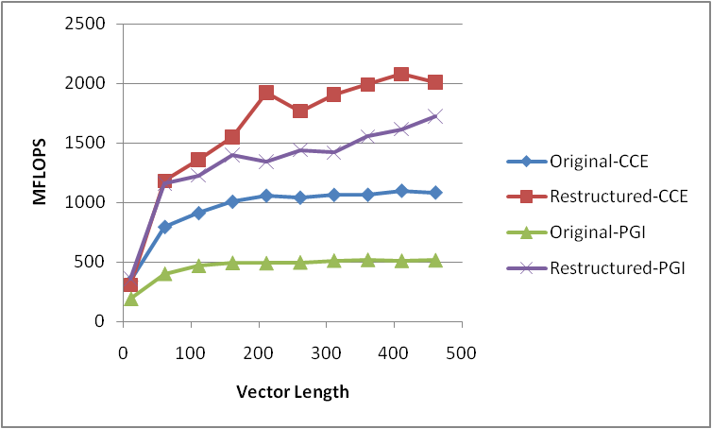
Performance for simple function call

Slide 39
Subroutine Call within Do Loop – without inlining
42. 1 C THE ORIGINAL
43. 1
44. 1 2----< DO 48070 I = 1, N
45. 1 2 A(I) = (B(I)**2 + C(I)**2)
46. 1 2 CT = PI * A(I) + (A(I))**2
47. 1 2 CALL SSUB (A(I), CT, D(I), E(I))
48. 1 2 F(I) = (ABS (E(I)))
49. 1 2----> 48070 CONTINUE
ftn-6288 ftn: VECTOR File = lp48070.f, Line = 44
A loop starting at line 44 was not vectorized because it contains a call to subroutine "SSUB" on line 47.

Slide 40
Subroutine Call within Do Loop – Restructured
71. 1 Vr4--< DO 48071 I = 1, N
72. 1 Vr4 A(I) = (B(I)**2 + C(I)**2)
73. 1 Vr4 CT = PI * A(I) + (A(I))**2
74. 1 Vr4 E(I) = A(I)**2 + (ABS (A(I) + CT)) * (CT * ABS (A(I) - CT))
75. 1 Vr4 D(I) = A(I) + CT
76. 1 Vr4 F(I) = (ABS (E(I)))
77. 1 Vr4--> 48071 CONTINUE
ftn-6005 ftn: SCALAR File = lp48070.f, Line = 71
A loop starting at line 71 was unrolled 4 times.
ftn-6204 ftn: VECTOR File = lp48070.f, Line = 71
A loop starting at line 71 was vectorized.

Slide 41
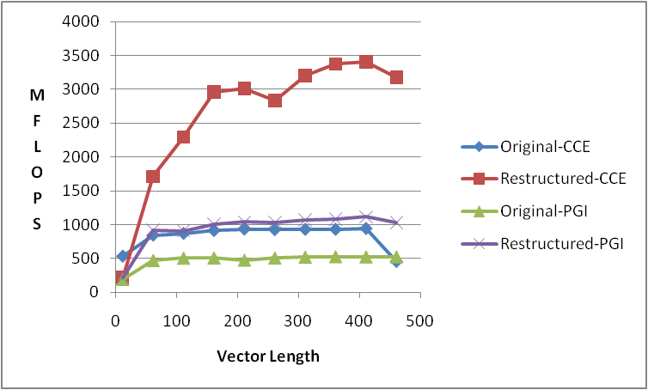
Performance for PGI And CCE

Slide 42
Subroutine Calls from within Do Loops
 | Statement Function | Inline | Vector routine
Simple | X | X
Very large routine calling other routines |  |  | X
Very small |  | X
When complications exist with COMMON and/or MODULES |  |  | X

Slide 43
Fortran 90 Array Syntax
11. !
12. ! dP_1/dT
13. Vfr4----<> WORK3 = mwjfnums0t1 + TQ * (c2*mwjfnums0t2 + &
14. c3*mwjfnums0t3 * TQ) + mwjfnums1t1 * SQ
15. ! dP_2/dT
16. f-------<> WORK4 = mwjfdens0t1 + SQ * mwjfdens1t1 + &
17. TQ * (c2*(mwjfdens0t2 + SQ*SQR*mwjfdensqt2) + &
18. TQ * (c3*(mwjfdens0t3 + SQ * mwjfdens1t3) + &
19. TQ * c4*mwjfdens0t4))
20. Vr4-----<> DRHODT = (WORK3 - WORK1*DENOMK*WORK4)*DENOMK
ftn-6005 ftn: SCALAR File = pop_state.f90, Line = 13
A loop starting at line 13 was unrolled 4 times.
ftn-6204 ftn: VECTOR File = pop_state.f90, Line = 13
A loop starting at line 13 was vectorized.
ftn-6004 ftn: SCALAR File = pop_state.f90, Line = 16
A loop starting at line 16 was fused with the loop starting at line 13.
ftn-6005 ftn: SCALAR File = pop_state.f90, Line = 20
A loop starting at line 20 was unrolled 4 times.
ftn-6204 ftn: VECTOR File = pop_state.f90, Line = 20
A loop starting at line 20 was vectorized.

Slide 44
Rewrite into DO loop
34. 1--------< DO K=1,NZBLOCK
35. 1 2------< DO J=1,NYBLOCK
36. 1 2 Vr4--< DO I=1,NXBLOCK
37. 1 2 Vr4 WORK3(I,J,K) = mwjfnums0t1 + TQ(I,J,K) * (c2*mwjfnums0t2 + &
38. 1 2 Vr4 c3*mwjfnums0t3 * TQ(I,J,K)) + mwjfnums1t1 * SQ(I,J,K)
39. 1 2 Vr4 WORK4(I,J,K) = mwjfdens0t1 + SQ(I,J,K) * mwjfdens1t1 + &
40. 1 2 Vr4 TQ(I,J,K) * (c2*(mwjfdens0t2 + SQ(I,J,K) *SQR(I,J,K) *mwjfdensqt2) + &
41. 1 2 Vr4 TQ(I,J,K) * (c3*(mwjfdens0t3 + SQ(I,J,K) * mwjfdens1t3) + &
42. 1 2 Vr4 TQ(I,J,K) * c4*mwjfdens0t4))
43. 1 2 Vr4 DRHODT(I,J,K) = (WORK3(I,J,K) - WORK1(I,J,K) *DENOMK(I,J,K) * &
44. 1 2 Vr4 WORK4(I,J,K))*DENOMK(I,J,K)
45. 1 2 Vr4--> ENDDO
46. 1 2------> ENDDO
47. 1--------> ENDDO

Slide 45
Rewrite into DO loop
ftn-6294 ftn: VECTOR File = pop_state.f90, Line = 34
A loop starting at line 34 was not vectorized because a better candidate was found at line 36.
ftn-6294 ftn: VECTOR File = pop_state.f90, Line = 35
A loop starting at line 35 was not vectorized because a better candidate was found at line 36.
ftn-6005 ftn: SCALAR File = pop_state.f90, Line = 36
A loop starting at line 36 was unrolled 4 times.
ftn-6204 ftn: VECTOR File = pop_state.f90, Line = 36
A loop starting at line 36 was vectorized.

Slide 46
Results
 | Time(seconds) CCE PGI |  | TLB refs/miss CCE PGI |  | Level 1 refs/miss CCE PGI
Original Array Syntax | .260 | .185 | 324 | 400 | 114 | 23
Fortran DO Loop | .088 | .114 | 490 | 533 | 248 | 53

Slide 47
Derived Types
!$OMP PARALLEL DO DEFAULT(SHARED) PRIVATE(N)
DO N = 1,NUMRT
MOTION(N)%Ax = NODE(N)%Minv * (FORCE(N)%Xext-FORCE(N)%Xint)
MOTION(N)%Ay = NODE(N)%Minv * (FORCE(N)%Yext-FORCE(N)%Yint)
MOTION(N)%Az = NODE(N)%Minv * (FORCE(N)%Zext-FORCE(N)%Zint)
ENDDO
!$OMP END PARALLEL DO

Slide 48
Looking at the Derived Type
TYPE :: motion_type
REAL(KIND(0D0)) Px ! Initial x-position
REAL(KIND(0D0)) Py ! Initial y-position
REAL(KIND(0D0)) Pz ! Initial z-position
REAL(KIND(0D0)) Ux ! X displacement
REAL(KIND(0D0)) Uy ! Y displacement
REAL(KIND(0D0)) Uz ! Z displacement
REAL(KIND(0D0)) Vx ! X velocity
REAL(KIND(0D0)) Vy ! Y velocity
REAL(KIND(0D0)) Vz ! Z velocity
REAL(KIND(0D0)) Ax ! X acceleration
REAL(KIND(0D0)) Ay ! Y acceleration
REAL(KIND(0D0)) Az ! Z acceleration
END TYPE
TYPE (motion_type), DIMENSION(:), ALLOCATABLE :: MOTION

Slide 49
Hardware Counters for Derived Types
========================================================================
USER / solve_.LOOP@li.329
------------------------------------------------------------------------
Time% 4.5%
Time 12.197115 secs
Imb.Time 0.092292 secs
Imb.Time% 1.0%
Calls 42.9 /sec 523.0 calls
PAPI_L1_DCM 13.700M/sec 167144470 misses
PAPI_TLB_DM 0.448M/sec 5460907 misses
PAPI_L1_DCA 89.596M/sec 1093124368 refs
PAPI_FP_OPS 52.777M/sec 643917600 ops
User time (approx) 12.201 secs 32941756956 cycles 100.0%Time
Average Time per Call 0.023321 sec
CrayPat Overhead : Time 0.0%
HW FP Ops / User time 52.777M/sec 643917600 ops 0.5%peak(DP)
HW FP Ops / WCT 52.777M/sec
Computational intensity 0.02 ops/cycle 0.59 ops/ref
MFLOPS (aggregate) 52.78M/sec
TLB utilization 200.17 refs/miss 0.391 avg uses
D1 cache hit,miss ratios 84.7% hits 15.3% misses
D1 cache utilization (M) 6.54 refs/miss 0.817 avg uses
========================================================================

Slide 50
TLB and Cache optimization
Efficient TLB utilization is the most important
Efficient Cache utlization is next
Even when the Hardware counters look good, perhaps the performance could be better

Slide 51
Original
C TENTH ORDER EXPLICIT DIFFERENCES
KCM4 = KSTART-5
KCM3 = KSTART-4
KCM2 = KSTART-3
KCM1 = KSTART-2
KCCC = KSTART-1
KCP1 = KSTART
KCP2 = KSTART+1
KCP3 = KSTART+2
KCP4 = KSTART+3
KCP5 = KSTART+4
DO KC = KSTART,KFINIS
KCM5 = KCM4
KCM4 = KCM3
KCM3 = KCM2
KCM2 = KCM1
KCM1 = KCCC
KCCC = KCP1
KCP1 = KCP2
KCP2 = KCP3
KCP3 = KCP4
KCP4 = KCP5
KCP5 = KC+5
DO JC = JSTAL,JSTOL
DO IC = ISTAL,ISTOL
FDIFFA = FUNCTN(IC,JC,KCP1) - FUNCTN(IC,JC,KCM1)
FDIFFB = FUNCTN(IC,JC,KCP2) - FUNCTN(IC,JC,KCM2)
FDIFFC = FUNCTN(IC,JC,KCP3) - FUNCTN(IC,JC,KCM3)
FDIFFD = FUNCTN(IC,JC,KCP4) - FUNCTN(IC,JC,KCM4)
FDIFFE = FUNCTN(IC,JC,KCP5) - FUNCTN(IC,JC,KCM5)
FDERIV(IC,JC,KC) = ACOFFZ*FDIFFA
+ + BCOFFZ*FDIFFB
+ + CCOFFZ*FDIFFC
+ + DCOFFZ*FDIFFD
+ + ECOFFZ*FDIFFE
ENDDO
ENDDO
ENDDO
USER / dfbydz_
------------------------------------------------------------------------
Time% 18.0%
Time 60.409598 secs
Imb.Time 2.173818 secs
Imb.Time% 4.5%
Calls 7.0 /sec 425.0 calls
PAPI_L2_DCM 4.157M/sec 251128768 misses
PAPI_L3_TCM 59.267M/sec 3580536397 misses
PAPI_L1_DCA 288.456M/sec 17426686723 refs
PAPI_L2_DCA 26.338M/sec 1591193058 refs
User time (approx) 60.414 secs 138951625000 cycles 100.0%Time
Average Time per Call 0.142140 sec
CrayPat Overhead : Time 0.0%
D2 cache hit,miss ratio 84.2% hits 15.8% misses
D1+D2 cache hit,miss ratio 98.6% hits 1.4% misses
D1+D2 cache utilization 69.39 refs/miss 8.674 avg uses

Slide 52
Restructured
USER / dfbydz_
------------------------------------------------------------------------
Time% 7.2%
Time 20.455095 secs
Imb.Time 0.193765 secs
Imb.Time% 1.2%
Calls 20.8 /sec 425.0 calls
PAPI_L2_DCM 1.672M/sec 34198070 misses
PAPI_L3_TCM 47.238M/sec 966026655 misses
PAPI_L1_DCA 704.145M/sec 14399773960 refs
PAPI_L2_DCA 72.230M/sec 1477100002 refs
User time (approx) 20.450 secs 47035000000 cycles
Average Time per Call 0.048130 sec
CrayPat Overhead : Time 0.0%
D2 cache hit,miss ratio 97.7% hits 2.3% misses
D1+D2 cache hit,miss ratio 99.8% hits 0.2% misses
D1+D2 cache utilization 421.07 refs/miss 52.634 avg uses
DO I3BLOCK = KSTART,KFINIS,BLOCK3
DO I2BLOCK=JSTAL,JSTOL,BLOCK2
DO KC = I3BLOCK,min(KFINIS,I3BLOCK+BLOCK3-1)
KCM5 = KCM4
KCM4 = KCM3
KCM3 = KCM2
KCM2 = KCM1
KCM1 = KCCC
KCCC = KCP1
KCP1 = KCP2
KCP2 = KCP3
KCP3 = KCP4
KCP4 = KCP5
KCP5 = KC+5
DO JC = I2BLOCK,min(JSTOL,I2BLOCK+BLOCK2-1)
DO IC = ISTAL,ISTOL
FDIFFA = FUNCTN(IC,JC,KCP1) - FUNCTN(IC,JC,KCM1)
FDIFFB = FUNCTN(IC,JC,KCP2) - FUNCTN(IC,JC,KCM2)
FDIFFC = FUNCTN(IC,JC,KCP3) - FUNCTN(IC,JC,KCM3)
FDIFFD = FUNCTN(IC,JC,KCP4) - FUNCTN(IC,JC,KCM4)
FDIFFE = FUNCTN(IC,JC,KCP5) - FUNCTN(IC,JC,KCM5)
FDERIV(IC,JC,KC) = ACOFFZ*FDIFFA
+ + BCOFFZ*FDIFFB
+ + CCOFFZ*FDIFFC
+ + DCOFFZ*FDIFFD
+ + ECOFFZ*FDIFFE
ENDDO
ENDDO
ENDDO
ENDDO
ENDDO

Slide 53
NPB MG routine RESID
do i3=2,n3-1
do i2=2,n2-1
do i1=1,n1
u1(i1) = u(i1,i2-1,i3) + u(i1,i2+1,i3)
> + u(i1,i2,i3-1) + u(i1,i2,i3+1)
u2(i1) = u(i1,i2-1,i3-1) + u(i1,i2+1,i3-1)
> + u(i1,i2-1,i3+1) + u(i1,i2+1,i3+1)
enddo
do i1=2,n1-1
r(i1,i2,i3) = v(i1,i2,i3)
> - a(0) * u(i1,i2,i3)
> - a(2) * ( u2(i1) + u1(i1-1) + u1(i1+1) )
> - a(3) * ( u2(i1-1) + u2(i1+1) )
enddo
enddo
enddo

Slide 54
========================================================================
USER / resid_
------------------------------------------------------------------------
Time% 42.4%
Time 12.397761
Imb.Time 0.000370
Imb.Time% 0.0%
Calls 340
PAPI_L1_DCA 2719.188M/sec 33711498004 ops
DC_L2_REFILL_MOESI 79.644M/sec 987402929 ops
DC_SYS_REFILL_MOESI 4.059M/sec 50318116 ops
BU_L2_REQ_DC 129.172M/sec 1601429574 req
User time 12.398 secs 32233848320 cycles
Utilization rate 100.0%
L1 Data cache misses 83.703M/sec 1037721045 misses
LD & ST per D1 miss 32.49 ops/miss
D1 cache hit ratio 96.9%
LD & ST per D2 miss 669.97 ops/miss
D2 cache hit ratio 96.9%
L2 cache hit ratio 95.2%
Memory to D1 refill 4.059M/sec 50318116 lines
Memory to D1 bandwidth 247.723MB/sec 3220359424 bytes
L2 to Dcache bandwidth 4861.112MB/sec 63193787456 bytes
========================================================================

Slide 55
Entire Cube does not fit in
L2 Cache
256*256*256*3 arrays
= 402 MBytes
n2
i2 +1
i3 + 1
i1 +1
n2
i1 -1
i3 - 1
i2 - 1
Take data in chunks that
Fit in L2 Cache
256*16*32*3 arrays
= 1 MBytes
Chunk Fits in L2 Cache
n3
n1

Slide 56
Tiling for better Cache utilization
do i3block=2,n3-1,BLOCK3
do i2block=2,n2-1,BLOCK2
do i3=i3block,min(n3-1,i3block+BLOCK3-1)
do i2=i2block,min(n2-1,i2block+BLOCK2-1)
do i1=1, n1
u1(i1) = u(i1,i2-1,i3) + u(i1,i2+1,i3)
> + u(i1,i2,i3-1) + u(i1,i2,i3+1)
u2(i1) = u(i1,i2-1,i3-1) + u(i1,i2+1,i3-1)
> + u(i1,i2-1,i3+1) + u(i1,i2+1,i3+1)
enddo
do i1=1, n1
r(i1,i2,i3) = v(i1,i2,i3)
> - a(0) * u(i1,i2,i3)
> - a(2) * ( u2(i1) + u1(i1-1) + u1(i1+1) )
> - a(3) * ( u2(i1-1) + u2(i1+1) )
enddo
enddo
enddo
enddo
enddo

Slide 57
========================================================================
USER / resid_
------------------------------------------------------------------------
Time% 36.3%
Time 8.753226
Imb.Time 0.000596
Imb.Time% 0.0%
Calls 340
PAPI_L1_DCA 3861.533M/sec 33800955933 ops
DC_L2_REFILL_MOESI 116.399M/sec 1018867620 ops
DC_SYS_REFILL_MOESI 2.755M/sec 24114222 ops
BU_L2_REQ_DC 161.490M/sec 1413560527 req
User time 8.753 secs 22758444048 cycles
Utilization rate 100.0%
L1 Data cache misses 119.154M/sec 1042981842 misses
LD & ST per D1 miss 32.41 ops/miss
D1 cache hit ratio 96.9%
LD & ST per D2 miss 1401.70 ops/miss
D2 cache hit ratio 98.3%
L2 cache hit ratio 97.7%
Memory to D1 refill 2.755M/sec 24114222 lines
Memory to D1 bandwidth 168.145MB/sec 1543310208 bytes
L2 to Dcache bandwidth 7104.420MB/sec 65207527680 bytes

Slide 58
do i3block=2,n3-1,BLOCK3
do i2block=2,n2-1,BLOCK2
do i3=i3block,min(n3-1,i3block+BLOCK3-1)
do i2=i2block,min(n2-1,i2block+BLOCK2-1)
do i1=1,n1
u1(i1) = u(i1,i2-1,i3) + u(i1,i2+1,i3)
> + u(i1,i2,i3-1) + u(i1,i2,i3+1)
u2(i1) = u(i1,i2-1,i3-1) + u(i1,i2+1,i3-1)
> + u(i1,i2-1,i3+1) + u(i1,i2+1,i3+1)
enddo
do i1=2,n1-1
r(i1,i2,i3) = v(i1,i2,i3)
> - a(0) * u(i1,i2,i3)
> - a(2) * ( u2(i1) + u1(i1-1) + u1(i1+1) )
> - a(3) * ( u2(i1-1) + u2(i1+1) )
enddo
enddo
enddo
enddo
enddo

Slide 59
do i3block=2,n3-1,BLOCK3
do i2block=2,n2-1,BLOCK2
do i3=i3block,min(n3-1,i3block+BLOCK3-1)
do i2=i2block,min(n2-1,i2block+BLOCK2-1)
do i1=2,n1-1
u21 = u(i1,i2-1,i3-1) + u(i1,i2+1,i3-1)
> + u(i1,i2-1,i3+1) + u(i1,i2+1,i3+1)
u21p1 = u(i1+1,i2-1,i3-1) + u(i1+1,i2+1,i3-1)
> + u(i1+1,i2-1,i3+1) + u(i1+1,i2+1,i3+1)
u21m1 = u(i1-1,i2-1,i3-1) + u(i1-1,i2+1,i3-1)
> + u(i1-1,i2-1,i3+1) + u(i1-1,i2+1,i3+1)
u11p1 = u(i1+1,i2-1,i3) + u(i1+1,i2+1,i3)
> + u(i1+1,i2,i3-1) + u(i1+1,i2,i3+1)
u11m1 = u(i1-1,i2-1,i3) + u(i1-1,i2+1,i3)
> + u(i1-1,i2,i3-1) + u(i1-1,i2,i3+1)
r(i1,i2,i3) = v(i1,i2,i3)
> - a(0) * u(i1,i2,i3)
> - a(2) * ( u21 + u11m1 + u11p1 )
> - a(3) * ( u21m1 + u21p1 )
enddo
enddo
enddo
enddo
enddo

Slide 60
MHD3D Original
DO 200 K=0,KX
DO 200 J=0,JX
DO 200 I=0,IX
F(I,J,K)=RVX(I,J,K)
G(I,J,K)=RVY(I,J,K)
H(I,J,K)=RVZ(I,J,K)
S(I,J,K)=0.
200 CONTINUE
CALL HALF(RO,ROH,DRO,F,G,H,S)

Slide 61
Original HALF
C=======================================================================
DO 100 K=1,KXS1
DO 100 J=1,JXS1
DO 100 I=1,IXS1
DU(I,J,K)=DU(I,J,K)-0.5*DT*
& (0.5*RDXM(I)*(F(I+1,J,K)-F(I-1,J,K))
& +0.5*RDYM(J)*(G(I,J+1,K)-G(I,J-1,K))
& +0.5*RDZM(K)*(H(I,J,K+1)-H(I,J,K-1))
& +S(I,J,K))
100 CONTINUE
C=======================================================================
C*** proceed half step using flux across cell boundary ***
C=======================================================================

Slide 62
Original HALF
DO 200 K=0,KXS1
DO 200 J=0,JXS1
DO 200 I=0,IXS1
C----------- cell average ---------------------
UH =0.125*(U(I+1,J+1,K+1)+U(I,J+1,K+1)
& +U(I+1,J+1,K) +U(I,J+1,K)
& +U(I+1,J,K+1) +U(I,J,K+1)
& +U(I+1,J,K) +U(I,J,K))
SH =0.125*(S(I+1,J+1,K+1)+S(I,J+1,K+1)
& +S(I+1,J+1,K) +S(I,J+1,K)
& +S(I+1,J,K+1) +S(I,J,K+1)
& +S(I+1,J,K) +S(I,J,K))
C----------- flux across cell boundary ----------------------
DFDX = 0.25*RDX(I)*(F(I+1,J+1,K+1)-F(I, J+1,K+1)
& +F(I+1,J+1,K) -F(I, J+1,K)
& +F(I+1,J, K+1)-F(I, J, K+1)
& +F(I+1,J, K) -F(I, J, K))
DGDY = 0.25*RDY(J)*(G(I+1,J+1,K+1)-G(I+1,J, K+1)
& +G(I+1,J+1,K) -G(I+1,J, K)
& +G(I, J+1,K+1)-G(I, J, K+1)
& +G(I, J+1,K) -G(I, J, K))
DHDZ = 0.25*RDZ(K)*(
& H(I+1,J+1,K+1)-H(I+1,J+1,K)
& +H(I+1,J, K+1)-H(I+1,J, K)
& +H(I, J+1,K+1)-H(I, J+1,K)
& +H(I, J, K+1)-H(I, J, K))
C------------ summation of all terms ------------------------
UN(I,J,K) = UH-DT*(DFDX+DGDY+DHDZ+SH)
200 CONTINUE
RETURN
END

Slide 63
Storage Analysis
Original
 | Variables | NX | NY | NZ | Mwords | MB | L2 | TLBs
Loop 200 | 7 | 259 | 255 | 9 | 20.8 | 43.2 | 75 | 38
Half Do 100 | 5 | 259 | 255 | 9 | 2.972025 | 11.8881 | 23.7762 | 11
Half Do 200 | 6 | 259 | 255 | 9 | 3.56643 | 14.26572 | 28.53144 | 14

Slide 64
NZ
NX
NY
J-1
K+1
I-1
I+1
HALF needs I+1, J+1, K+1, So MLWXYZ must
Update a K plane ahead prior to call to HALF
K-1
J+1

Slide 65
MHD3D Restructured
DO K = 0,KX
KDOWN=K+1
KUP=K+1
IF(K.EQ.0)THEN
KDOWN=k
KUP=k+1
ENDIF
IF(K.EQ.KX)THEN
KDOWN=K+1
KUP=K
ENDIF
DO JJ = 0,JX,JBLOCK
JSTART = JJ
JSTOP = MIN(JSTART+JBLOCK,JX)
IF(JJ.NE.0)THEN
JSTART=JSTART+1
ENDIF

Slide 66
MDH3D Restructured
DO KK=KDOWN,KUP
DO 200 J=JSTART,JSTOP
DO 200 I=0,IX
F(I,J,KK)=RVX(I,J,KK)
G(I,J,KK)=RVY(I,J,KK)
H(I,J,KK)=RVZ(I,J,KK)
S(I,J,KK)=0.
200 CONTINUE
ENDDO
CALL HALF(JSTART,JSTOP,K,RO,ROH,DRO,F,G,H,S,0)

Slide 67
RESTRUCTURED HALF
IF(K.GT.0.AND.K.LE.KXS1)THEN
DO 100 J=MAX(1,JSTART),MIN(JXS1,JSTOP)
DO 100 I=1,IXS1
DU(I,J,K)=DU(I,J,K)-0.5*DT*
& (0.5*RDXM(I)*(F(I+1,J,K)-F(I-1,J,K))
& +0.5*RDYM(J)*(G(I,J+1,K)-G(I,J-1,K))
& +0.5*RDZM(K)*(H(I,J,K+1)-H(I,J,K-1))
& +S(I,J,K))
100 CONTINUE
ENDIF
C=======================================================================
C*** proceed half step using flux across cell boundary ***
C=======================================================================

Slide 68
RESTRUCTURED HALF
IF(K.LT.KX)THEN
DO 200 J=MAX(0,JSTART),MIN(JXS1,JSTOP)
DO 200 I=0,IXS1
C----------- cell average ---------------------
UH =0.125*(U(I+1,J+1,K+1)+U(I,J+1,K+1)
& +U(I+1,J+1,K) +U(I,J+1,K)
& +U(I+1,J,K+1) +U(I,J,K+1)
& +U(I+1,J,K) +U(I,J,K))
SH =0.125*(S(I+1,J+1,K+1)+S(I,J+1,K+1)
& +S(I+1,J+1,K) +S(I,J+1,K)
& +S(I+1,J,K+1) +S(I,J,K+1)
& +S(I+1,J,K) +S(I,J,K))
C----------- flux across cell boundary ----------------------
DFDX = 0.25*RDX(I)*(F(I+1,J+1,K+1)-F(I, J+1,K+1)
& +F(I+1,J+1,K) -F(I, J+1,K)
& +F(I+1,J, K+1)-F(I, J, K+1)
& +F(I+1,J, K) -F(I, J, K))
DGDY = 0.25*RDY(J)*(G(I+1,J+1,K+1)-G(I+1,J, K+1)
& +G(I+1,J+1,K) -G(I+1,J, K)
& +G(I, J+1,K+1)-G(I, J, K+1)
& +G(I, J+1,K) -G(I, J, K))
DHDZ = 0.25*RDZ(K)*(
& H(I+1,J+1,K+1)-H(I+1,J+1,K)
& +H(I+1,J, K+1)-H(I+1,J, K)
& +H(I, J+1,K+1)-H(I, J+1,K)
& +H(I, J, K+1)-H(I, J, K))
C------------ summation of all terms ------------------------
UN(I,J,K) = UH-DT*(DFDX+DGDY+DHDZ+SH)
200 CONTINUE

Slide 69
Storage Analysis
Restructured
 | Variables | NX | NY | NZ | Mwords | MB | L2 | TLB
Loop 200 | 7 | 259 | 32 | 2 | .116 | .464 | 1 | .47
Half Do 100 | 5 | 259 | 32 | 2 | 0.08288 | .32 | .66 | .33
Half Do 200 | 6 | 259 | 32 | 2 | 0.099456 | .39 | .8 | .39

Slide 70
Message passing optimization
Point to point optimization
Optimization of global functions

Slide 71
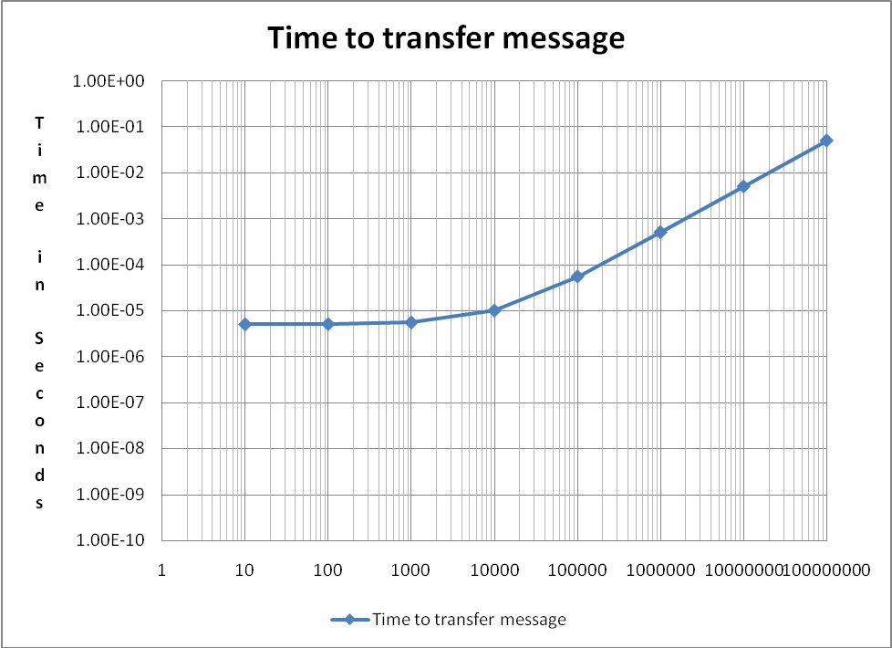
Time to transfer a message on Seastar 2+

Slide 72
Message Sizes
Notice that it is relatively the same time to transfer a message of 10,000 bytes as a message of 1,000 bytes
By packing 10 1,000 byte messages together, you will significantly save on message passing time with only a slight increase in computation

Slide 73
XT MPI – Receive Side
Unexpected long message buffers- Portals EQ event only
Portals matches incoming message with pre-posted receives and delivers message data directly into user buffer.
Unexpected short message buffers
An unexpected message generates two entries on unexpected EQ
Notes:
When a message is received by Portals, it's first checked to see if it matches any receives pre-posted by the application. If there is a match, Portals delivers the message data directly into the user buffer, and delivers an event to the "Other" event queue.
If there isn't a match to an application pre-posted receive, then Portals checks to see which of the internally posted match entries matches this message. Internally, MPI posts entries to match the "unexpected" messages. If the message matches the internal eager short message match entry, Portals copies the message data into one of the short unexpected internal data buffers, and generates events for the "Unexpected" event queue.
If the message matches the internal long message match entry, Portals delivers events to the "Unexpected" queue containing enough information to allow Portals to issue a GET of the requested data when a matching receive is eventually posted by the application.

Slide 74
POP
do j=jphys_b,jphys_e
do i=iphys_b,iphys_e
XOUT(i,j) = CC(i,j)*X(i ,j ) +
& CN(i,j)*X(i ,j+1) + CN(i,j-1)*X(i ,j-1) +
& CE(i,j)*X(i+1,j ) + CE(i-1,j)*X(i-1,j ) +
& CNE(i,j)*X(i+1,j+1) + CNE(i,j-1)*X(i+1,j-1) +
& CNE(i-1,j)*X(i-1,j+1) + CNE(i-1,j-1)*X(i-1,j-1)
end do
end do
call MPI_IRECV(XOUT(1,1), 1, mpi_ew_type, nbr_west,
& mpitag_wshift, MPI_COMM_OCN, request(3), ierr)
call MPI_IRECV(XOUT(iphys_e+1,1), 1, mpi_ew_type, nbr_east,
& mpitag_eshift, MPI_COMM_OCN, request(4), ierr)
call MPI_ISEND(XOUT(iphys_e+1-num_ghost_cells,1), 1,
& mpi_ew_type, nbr_east,
& mpitag_wshift, MPI_COMM_OCN, request(1), ierr)
call MPI_ISEND(XOUT(iphys_b,1), 1, mpi_ew_type, nbr_west,
& mpitag_eshift, MPI_COMM_OCN, request(2), ierr)
call MPI_WAITALL(4, request, status, ierr)
call MPI_IRECV(XOUT(1,jphys_e+1), 1, mpi_ns_type, nbr_north,
& mpitag_nshift, MPI_COMM_OCN, request(3), ierr)
call MPI_IRECV(XOUT(1,1), 1, mpi_ns_type, nbr_south,
& mpitag_sshift, MPI_COMM_OCN, request(4), ierr)
call MPI_ISEND(XOUT(1,jphys_b), 1, mpi_ns_type, nbr_south,
& mpitag_nshift, MPI_COMM_OCN, request(1), ierr)
call MPI_ISEND(XOUT(1,jphys_e+1-num_ghost_cells), 1,
& mpi_ns_type, nbr_north,
& mpitag_sshift, MPI_COMM_OCN, request(2), ierr)
call MPI_WAITALL(4, request, status, ierr)

Slide 75
POP
call MPI_IRECV(XOUT(1,1), 1, mpi_ew_type, nbr_west,
& mpitag_wshift, MPI_COMM_OCN, request(1), ierr)
call MPI_IRECV(XOUT(iphys_e+1,1), 1, mpi_ew_type, nbr_east,
& mpitag_eshift, MPI_COMM_OCN, request(2), ierr)
call MPI_IRECV(XOUT(1,jphys_e+1), 1, mpi_ns_type, nbr_north,
& mpitag_nshift, MPI_COMM_OCN, request(5), ierr)
call MPI_IRECV(XOUT(1,1), 1, mpi_ns_type, nbr_south,
& mpitag_sshift, MPI_COMM_OCN, request(6), ierr)
!-----------------------------------------------------------------------
do j=jphys_b,jphys_e
do i=iphys_b,iphys_e
XOUT(i,j) = CC(i,j)*X(i ,j ) +
& CN(i,j)*X(i ,j+1) + CN(i,j-1)*X(i ,j-1) +
& CE(i,j)*X(i+1,j ) + CE(i-1,j)*X(i-1,j ) +
& CNE(i,j)*X(i+1,j+1) + CNE(i,j-1)*X(i+1,j-1) +
& CNE(i-1,j)*X(i-1,j+1) + CNE(i-1,j-1)*X(i-1,j-1)
end do
end do

Slide 76
POP
i = 1
do n=1,num_ghost_cells
do j=jphys_b,jphys_e
buffer_east_snd(i)=XOUT(iphys_e+n-num_ghost_cells,j)
buffer_west_snd(i)=XOUT(iphys_b+n-1,j)
i=i+1
end do
end do
call MPI_ISEND(buffer_east_snd,
& buf_len_ew, MPI_DOUBLE_PRECISION, nbr_east,
& mpitag_wshift, MPI_COMM_OCN, request(3), ierr)
call MPI_ISEND(buffer_west_snd,
& buf_len_ew, MPI_DOUBLE_PRECISION, nbr_west,
& mpitag_eshift, MPI_COMM_OCN, request(4), ierr)
call MPI_WAITALL(2, request, status_wait, ierr)
i = 1
do n=1,num_ghost_cells
do j=jphys_b,jphys_e
XOUT(n,j) = buffer_west_rcv(i)
XOUT(iphys_e+n,j) = buffer_east_rcv(i)
i=i+1
end do
end do

Slide 77
POP
!--------------------
! send north-south boundary info
!--------------------
call MPI_ISEND(XOUT(1,jphys_e+1-num_ghost_cells), buf_len_ns,
& MPI_DOUBLE_PRECISION, nbr_north,
& mpitag_sshift, MPI_COMM_OCN, request(1), ierr)
call MPI_ISEND(XOUT(1,jphys_b), buf_len_ns,
& MPI_DOUBLE_PRECISION, nbr_south,
& mpitag_nshift, MPI_COMM_OCN, request(2), ierr)
call MPI_WAITALL(6, request, status, ierr)

Slide 78
When to pre-post receives
In reviewing the point to point communication, the following questions should be asked:
What is the earliest time I can receive the data that I need from my neighbor?
That is the point where a receive (MPI_IRECV) should be posted
Do I need to allocate a separate buffer, so I can be calculating on a previous message while I receive the next message for the next computation
How can I overlap communication with computation as much as possible
When can I send the data that the other processor needs
When must I wait to make sure my receive is completed
When must I wait to make sure my send is completed

Slide 79
In reviewing the point to point communication, the following questions should be asked:
What is the earliest time I can receive the data that I need from my neighbor?
That is the point where a receive (MPI_IRECV) should be posted
Do I need to allocate a separate buffer, so I can be calculating on
a previous message while I receive the next message for the next
computation
How can I overlap communication with computation as much as possible
When can I send the data that the other processor needs
When must I wait to make sure my receive is completed
When must I wait to make sure my send is completed

Slide 80
Optimizing Global Communications
MPI_ALLTOALL, MPI_ALLREDUCE, etc
Make sure that all MPI_ALLTOALL and MPI_ALLREDUCE are combined into a minimal number of calls
Currently all collectives are blocking calls
MPI 3 is proposing non-blocking collectives
Rather than using MPI_ALLGATHERV and MPI_ALLSCATTERV
Replace with point to point calls which can typically be overlapped with each other
Ultimately,
Overlapping computation with global collective can be done using CAF and UPC
For example, 3-D FFT could be written where the FFT computation is free, covered by the ALL-TO-ALL

Slide 81
Questions / Comments
Thank You!
CSC, Finland
September 21-24, 2009

